Slide 1
QuantSparse 3D Stage Report
Integrated Systems Laboratory (ETH Zürich)
Bowen Wang bowwang@iis.ee.ethz.ch Paul Scheffler paulsc@iis.ee.ethz.ch
Luca Benini lbenini@iis.ee.ethz.ch

Slide 2
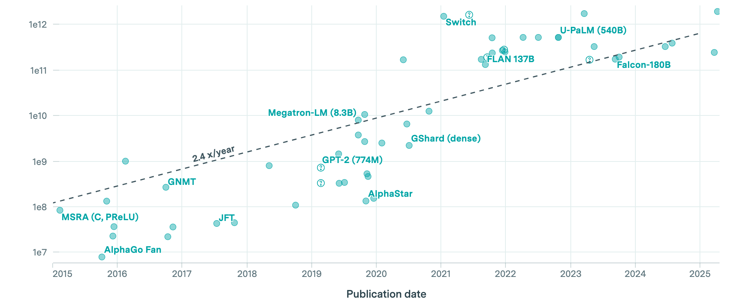
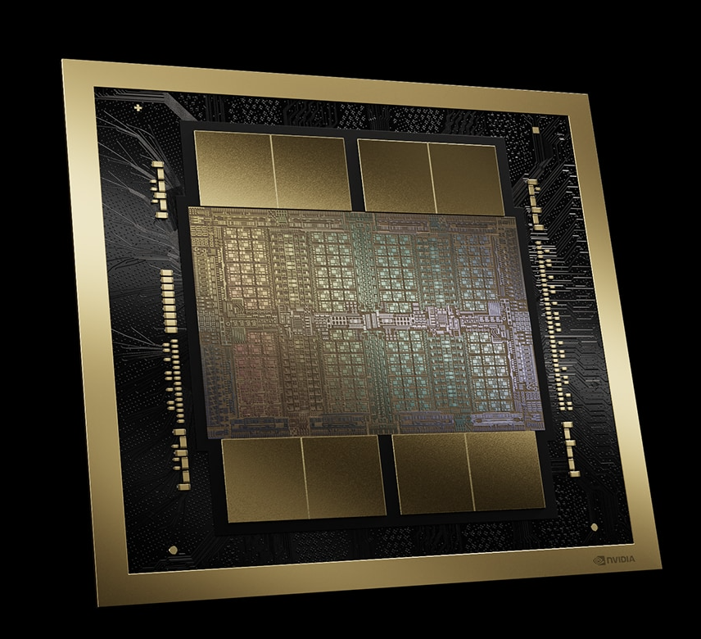
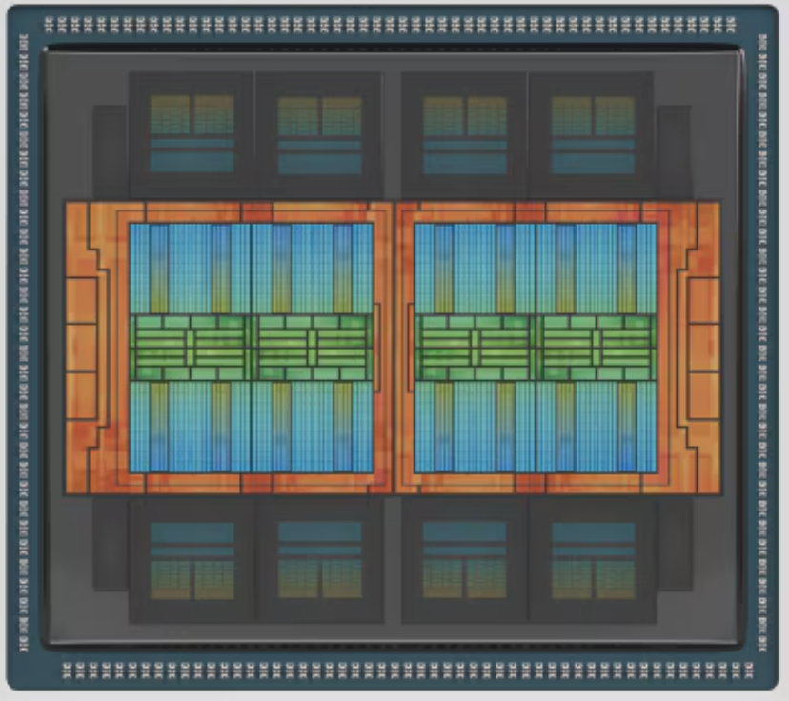
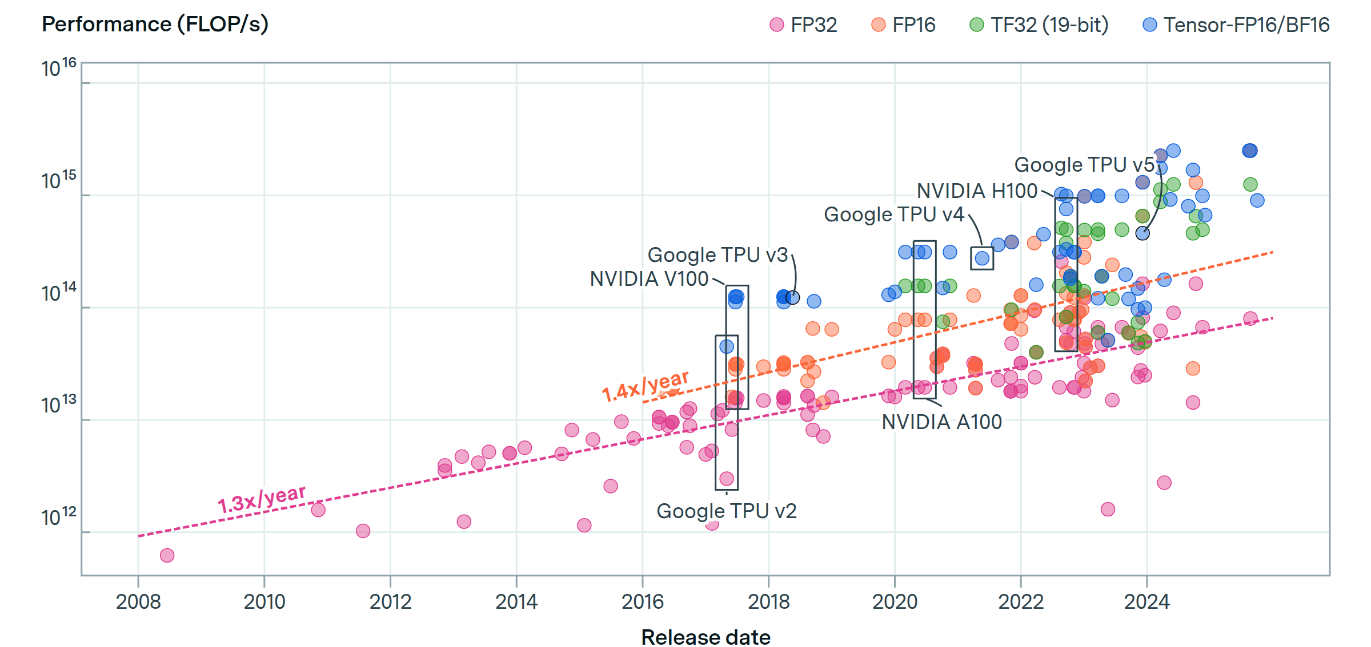
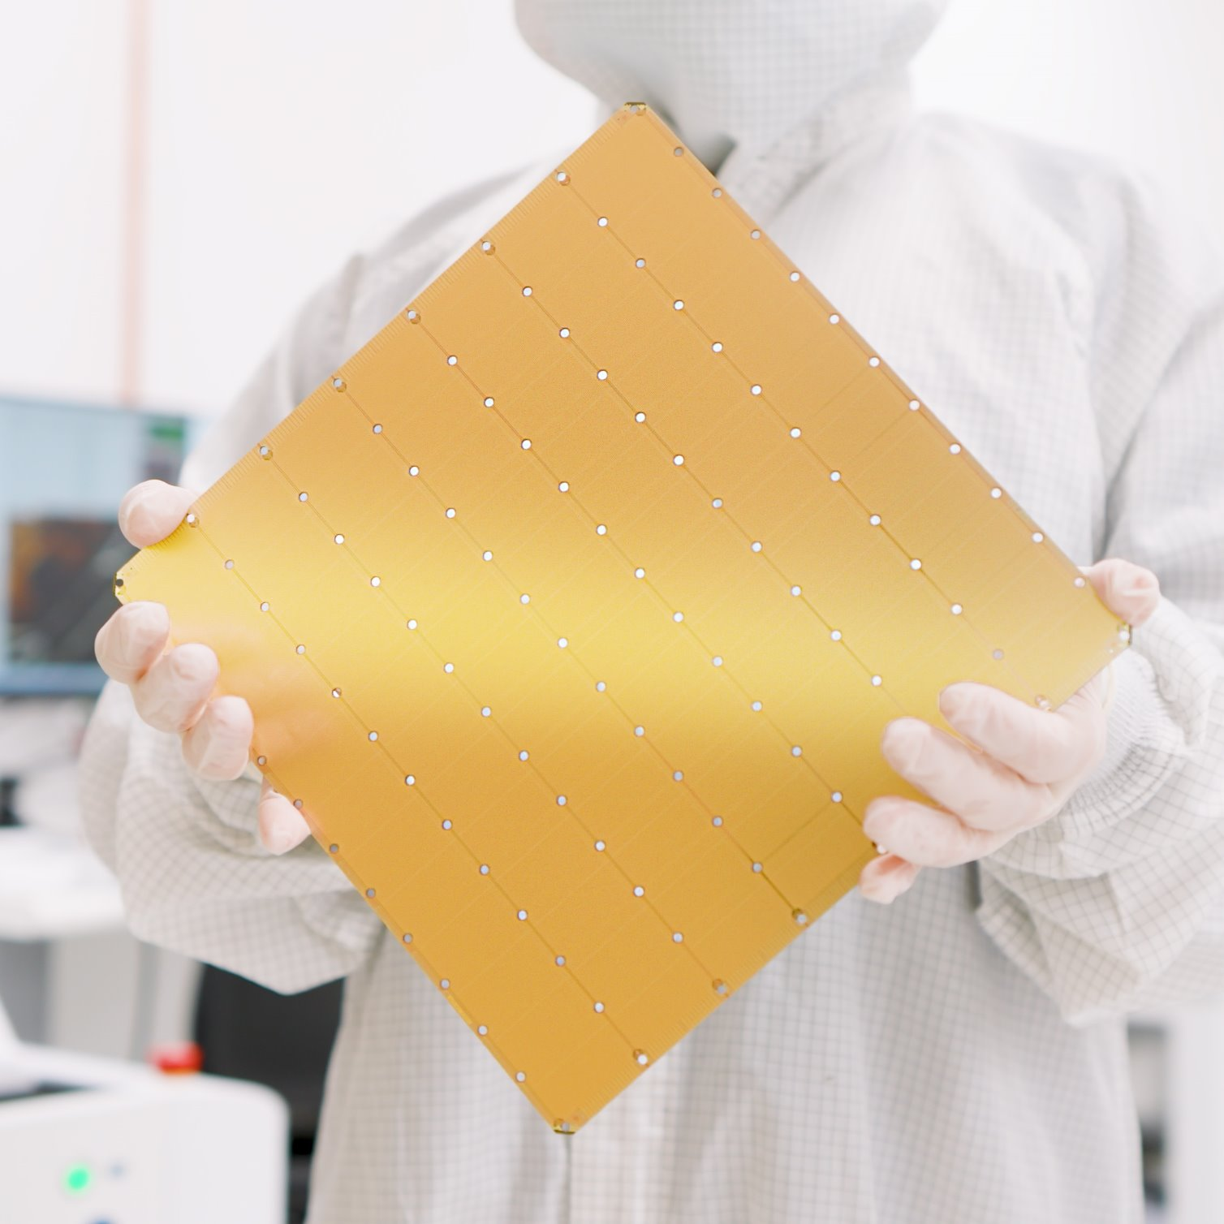
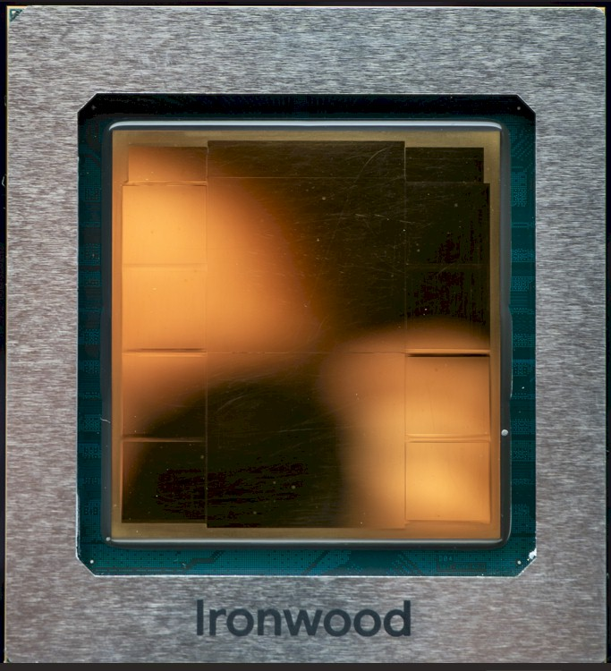
Model Scaling Outpaces Computing Capability
Number of parameters of frontier AI models
Modern ML platforms provide massively parallel computing capabilities through system scaling
2.4x/year
NVIDIA Blackwell^{[1]}
AMD INSTINCT MI355X^{[2]}
16,869 Scalar Cores + 528 Tensor Cores
16,384 Scalar Cores + 1024 Tensor Cores
Massively Parallel Architectures
Computational throughput of ML hardware
Cerebras WSE-3^{[3]}
Google TPU Ironwood^{[4]}
900,000 Scalar Cores
Scale out to 9,216 chips
1.3x/year
[1] T. Ajay, et al. "Nvidia blackwell platform: Advancing generative ai and accelerated computing." HCS ‘24.
[2] S. Alan, et al. "AMD InstinctTM MI300 series modular chiplet package–HPC and AI accelerator for exa-class systems." ISSCC ‘24.
[3] I. Lie, Sean. "Cerebras architecture deep dive: First look inside the hw/sw co-design for deep learning: Cerebras systems." HCS ‘22.
[4] J. Norman, et al. "Ironwood: Delivering Best in Class perf, perf/TCO and perf/Watt for Reasoning Model Training and Serving." HCS ‘25.

Slide 3
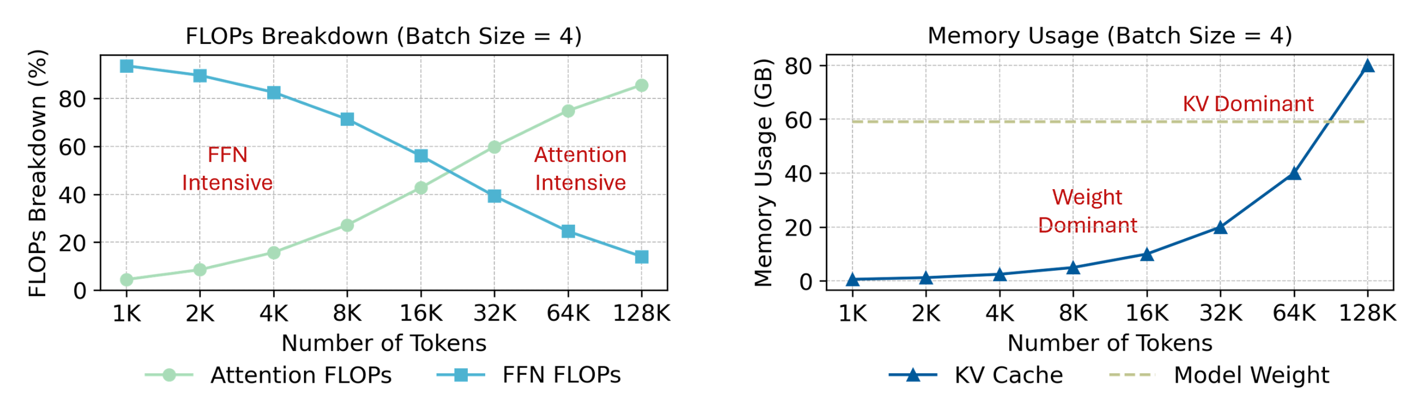
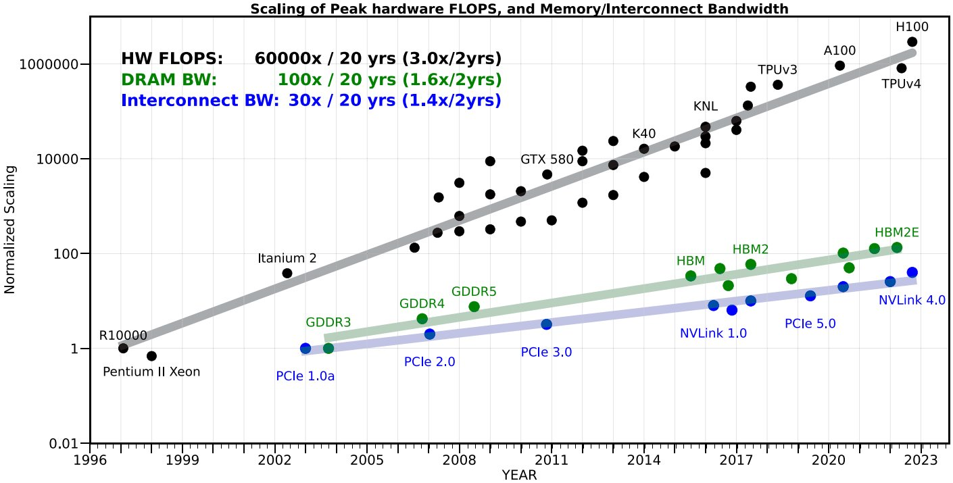
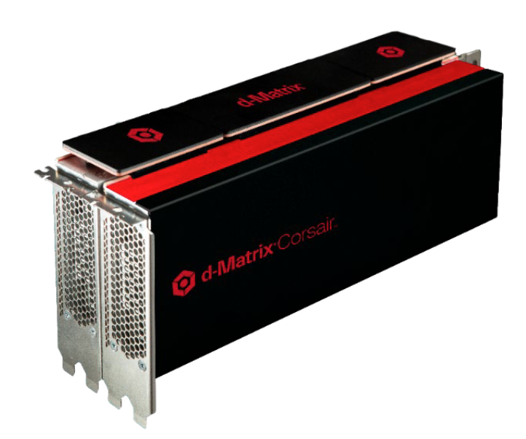
Expanding Memory Pressure
KV cache dominates memory usage in long context agentic inference workload
High-capacity + High-bandwidth on-chip memory
NVIDIA Blackwell
AMD INSTINCT MI355X
192 GB @ 8 TB/s HBM3e
288 GB @ 8 TB/s HBM3e
Memory BW growth cannot keep pace with Computing​
Advanced Integration
d-Matrix Corsair^{[1]}
Google TPU Ironwood
2 GB @ 150 TB/s DIMC
192 GB @ 7.4 TB/s HBM
[1] Bhoja, Sudeep. "CORSAIR: An In-Memory Computing Chiplet Architecture for Inference-Time Compute Acceleration." HCS ’25.

Slide 4
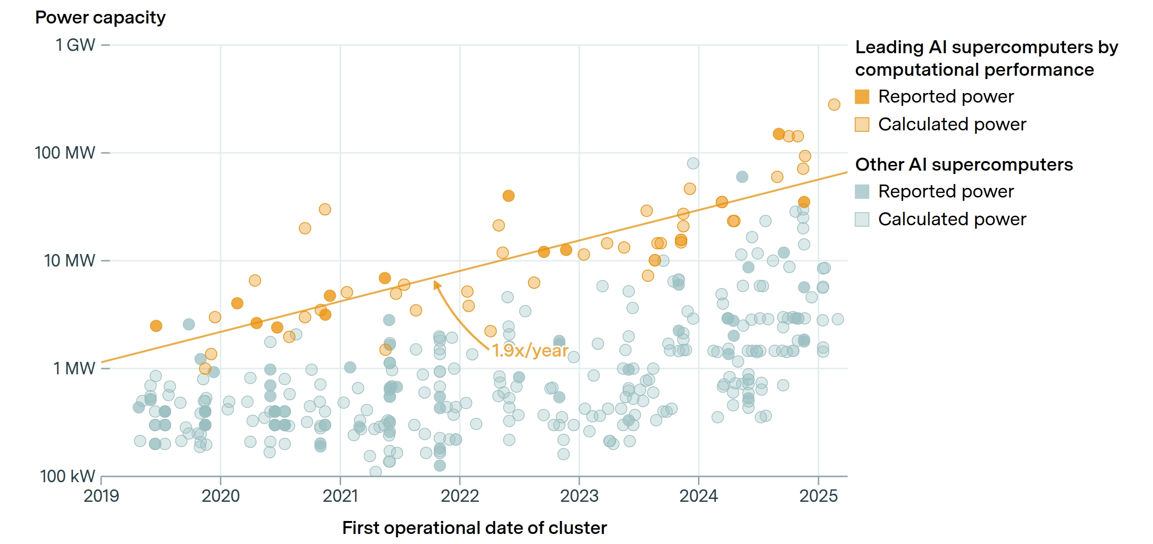
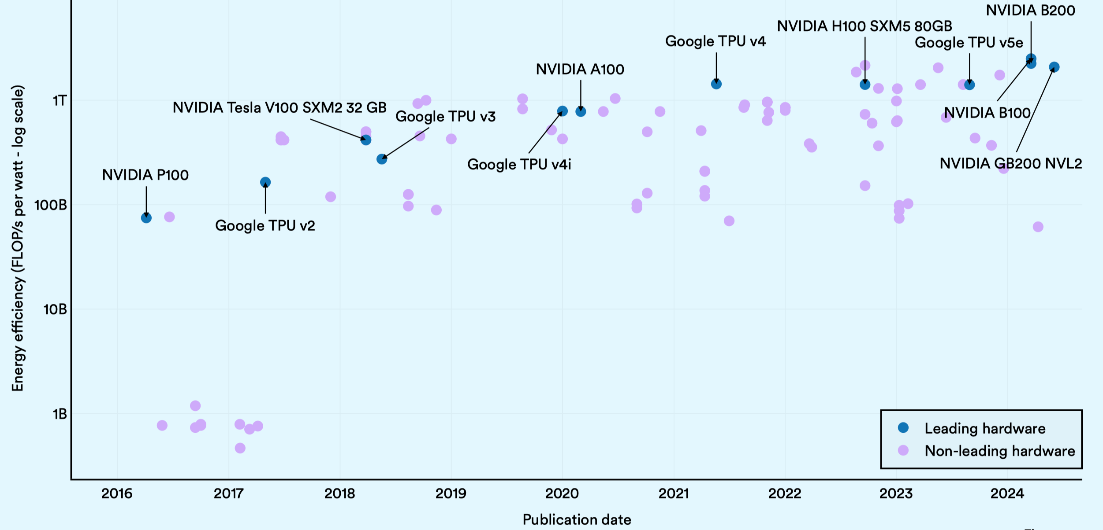
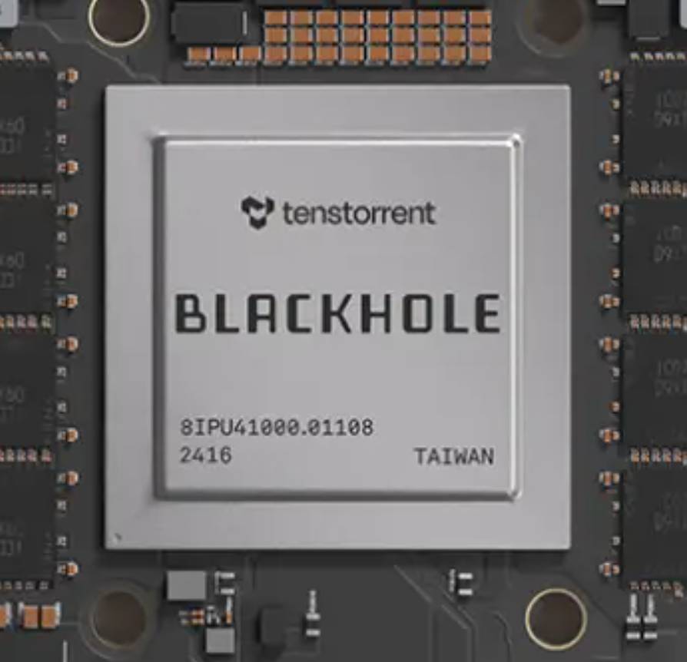
Rising Energy Cost
Power requirements of leading AI supercomputers
Driven by reducing data movement, computing specialization, and exploiting numerical co-design
1.9x/year
NVIDIA Blackwell
d-Matrix Corsair
FP4/FP8 Tensor Cores
NPU-style CIM
Algorithm Innovation
Energy Efficiency of leading ML hardware
Tenstorrent Blackhole^{[1]}
Google TPU Ironwood
Hardware Specialization
Dataflow-aware routing
Systolic array-based dataflow
1.3x/year
[1] BVasiljevic, Jasmina, and Davor Capalija. "Blackhole & tt-metalium: The standalone ai computer and its programming model." HCS ‘24.
Notes:
Google TPU (v1–v5 / IronWood): Systolic array-based dataflow minimizes memory access and exploits massive data reuse for MAC operations — a key source of energy savings. → Highlight: “Dataflow specialization to reduce off-chip movement.”
d-Matrix Corsair / NPU-style in-memory compute: The chiplet-based analog compute design moves MAC operations closer to SRAM banks, drastically reducing data transfer energy. → Highlight: “Near-memory compute to minimize energy per operation.”
Tenstorrent Blackhole: Emphasizes dataflow-aware routing and on-chip mesh network optimization for low-latency and energy-efficient transfers.

Slide 5

QuantSparse 3D Project Objective
Reduce the energy consumption of large model inference by combining quantization and sparsity techniques to maintain performance under power constraints
Project Structure (Year 1)
WP1: Architectural modeling, simulation, and design of the chiplet architecture
WP2: Multi-chiplet fabrics modeling and software environment for model deployment

Slide 6
Review of First-Year Work Packages
(WP1) Chiplet architecture and building blocks
Architectural modeling, simulation, and design of the chiplet architecture, including processing engines, on-chip interconnect, memories, and main memory endpoints (controllers and near/in memory compute units).
Parameterized RTL models will be built and synthesized on advanced technology models representative of state-of-the-art technologies to assess PPA.
(WP2) System and software design
Architectural modeling of multi-chiplet fabrics and 3D-stacked memories.
Software environment for mapping LLM models to the hardware architecture, leveraging open-source environments (PyTorch, TVM, LLVM) and open specifications (ONNX).
Design space exploration of system configurations using a set of simplified end-to-end models and microkernels, such as autoregressive inference using a KV-cache for long input sequences, also using micro-scaling formats to reduce memory and energy footprints.
Notes:
packages

Slide 7
QuantSparse3D: Model Quantization
Massive Models are a big deal
Models with billions and trillions of parameters
E.g., Open AI GPT, Google Gemini, Meta LLaMa
Challenging to run in cloud and on edge devices
Key challenges:
These models have massive computational and memory costs
Complex to deploy and tricky to evaluate
Key opportunities:
Intuitively, these models are heavily over-parameterized and highly compressible
We need efficient hardware and software support for “compact” representations
Can we obtain highly-compressed but accurate variants?
Main research direction: Model Quantization

Slide 8
The Frontier: Toward Low-Bit, Lossless* Quantization
Zoo of quantization ideas^{[1]}
Rescaling: SmoothQuant, Base-Q
Rotation/Permutations: QuaRot, OSTAQuant, DuQuant
Learned rotations: SpinQuant, FlatQuant
Outlier preservation: Atom, QUIK
Research mainstream: Post-training quantization compresses LLMs in one-shot
Weight-only quantization is helpful in the memory-bound regime
What about computational throughput?
Key idea: allows the multiplication to happen in lower precision
Going sub-8-bit exposes the limits of scalar quantization + fast-moving landscape calls for standardization
Microscaling (MX) format is emerging as the standard
* Lossless: reducing precision without causing any measurable degradation in model accuracy compared to full-precision.
[1] Lang, Jiedong, Zhehao Guo, and Shuyu Huang. "A comprehensive study on quantization techniques for large language models." 2024 4th International Conference on Artificial Intelligence, Robotics, and Communication (ICAIRC). IEEE, 2024.

Slide 9
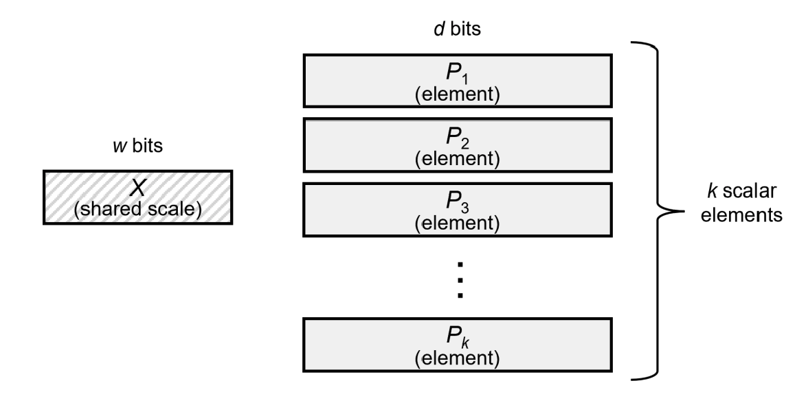
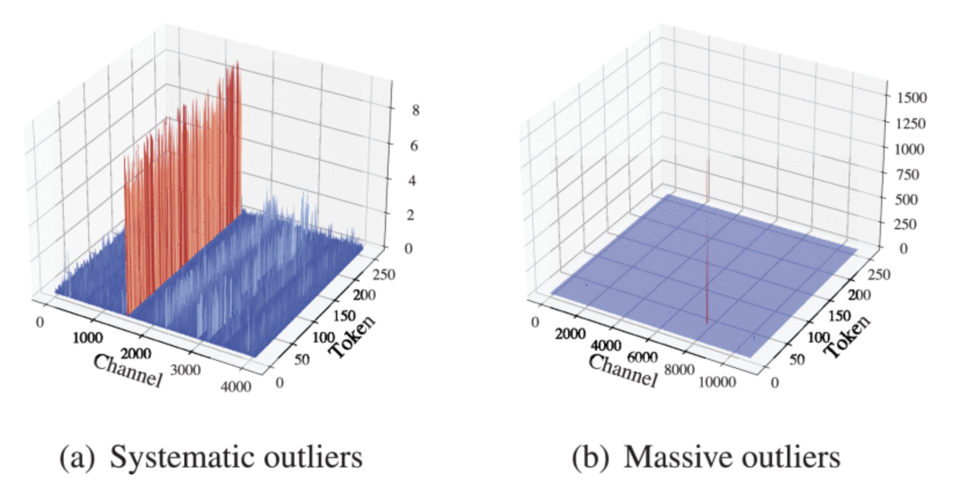
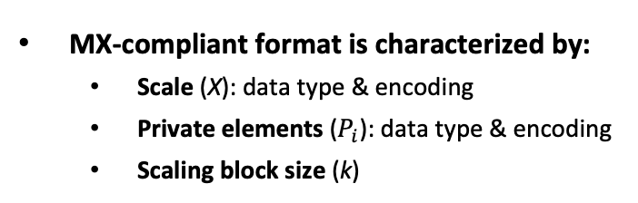
Block Quantization: Microscaling (MX)
OCP MX Specification^{[1]}
MX-compliant format is characterized by:
Scale (X): data type & encoding
Private elements ($P_{i}$): data type & encoding
Scaling block size (k)
32
8-bit (E8M0)
8-bit (E5M2 or E4M3)
MX provides higher effective dynamic range than scalar quantization
0.001~1% unstructured outlier overlay^{[2]}
Different layers demonstrate distinct outlier patterns
Represented with higher precision
Aggressive low-bit quantization requires both MX and explicit outlier handling Hardware must provide native, decoupled support
[1] Rouhani, Bita Darvish, et al. "Microscaling data formats for deep learning." arXiv preprint arXiv:2310.10537 (2023).
[2] Park, Jungwoo, et al. "Outlier-Safe Pre-Training for Robust 4-Bit Quantization of Large Language Models." arXiv preprint arXiv:2506.19697 (2025).
Notes:
https://ieeexplore.ieee.org/document/10994764?denied=

Slide 10
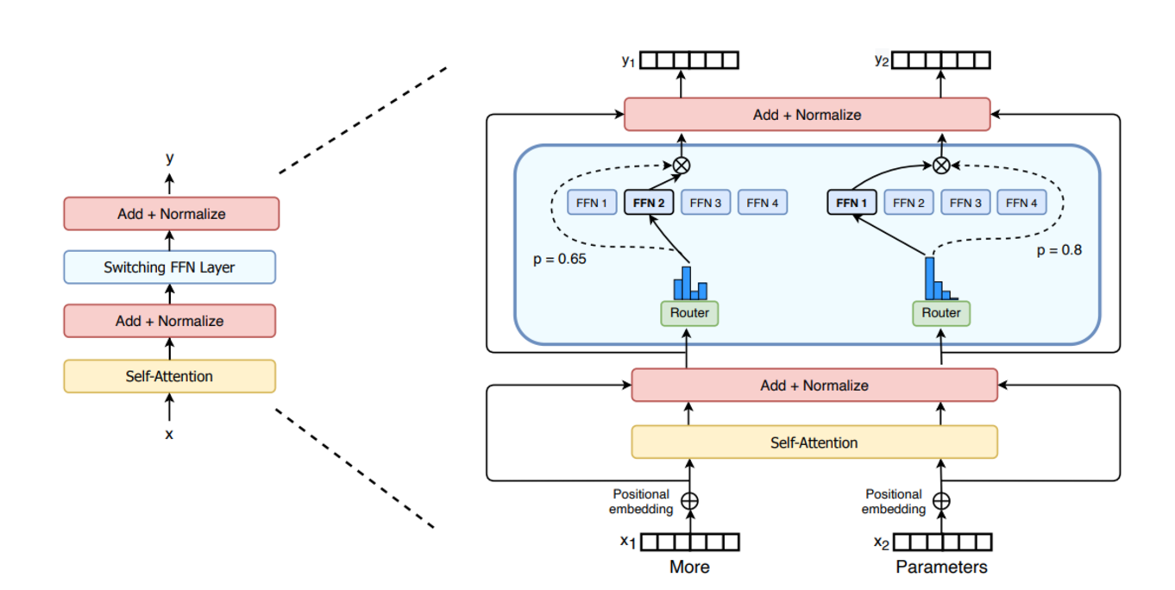
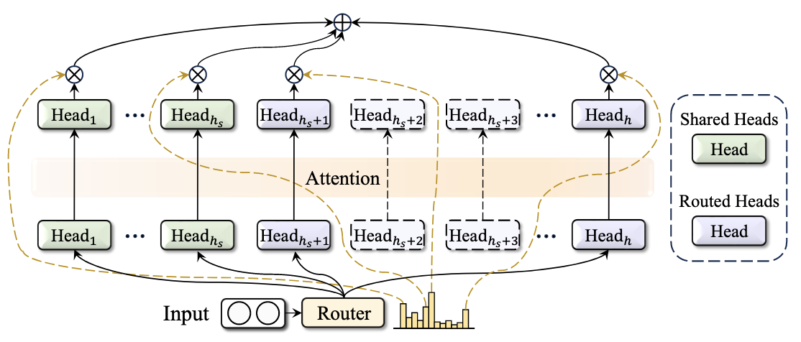
QuantSparse3D: Model Pruning
Coarse-Grained Sparsification
Large building blocks are removed; computation remains dense inside each kept block
Mixture-of-Expert (MoE) Models
Pruning removes entire experts, keeping only a small subset active per token
Requires compiler/runtime support to schedule experts
Layer dropping / block-level pruning
Remove attention blocks, MLP blocks, or entire layers
Token pruning
Reduces sequence length but does not change PE datapath
Coarse-grained pruning reduces macro-level workload, but compute kernels stay dense Handled at graph/compiler level

Slide 11
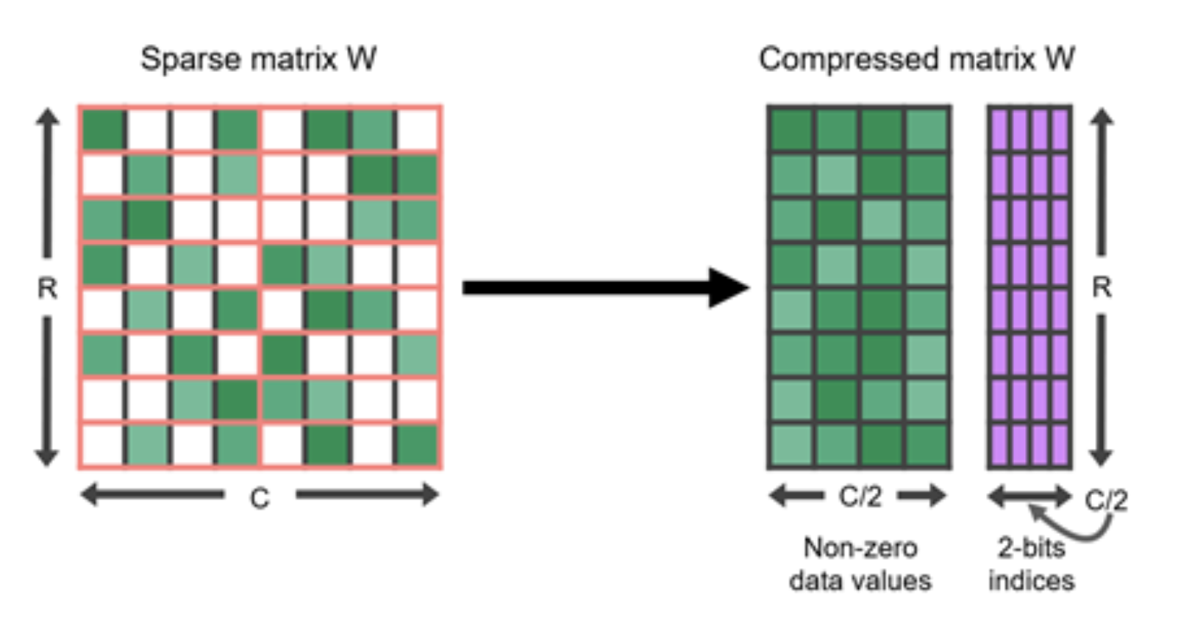
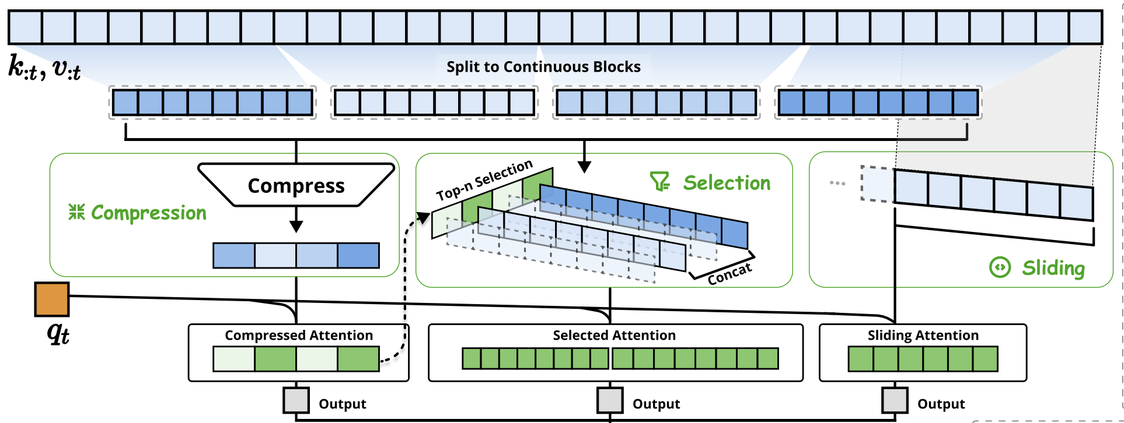
QuantSparse3D: Model Pruning
Fine-Grained Sparsification
Individual elements or small groups are removed
Weight Pruning
Structured: Strictly removing structured sets of parameters → 50%-75% sparsity rate
Unstructured: Arbitrary patterns of sparsification for parameters → 90% sparsity rate
Attention pruning (Sparse attention)
Unstructured attention score: Keep the Top-k largest attention score activations
Row-wise structured: Load the corresponding rows of the Value matrix from HBM endpoints
Fine-grained pruning dictates hardware datapath changes, specialized sparse-matmul units, and dedicated memory operations

Slide 12
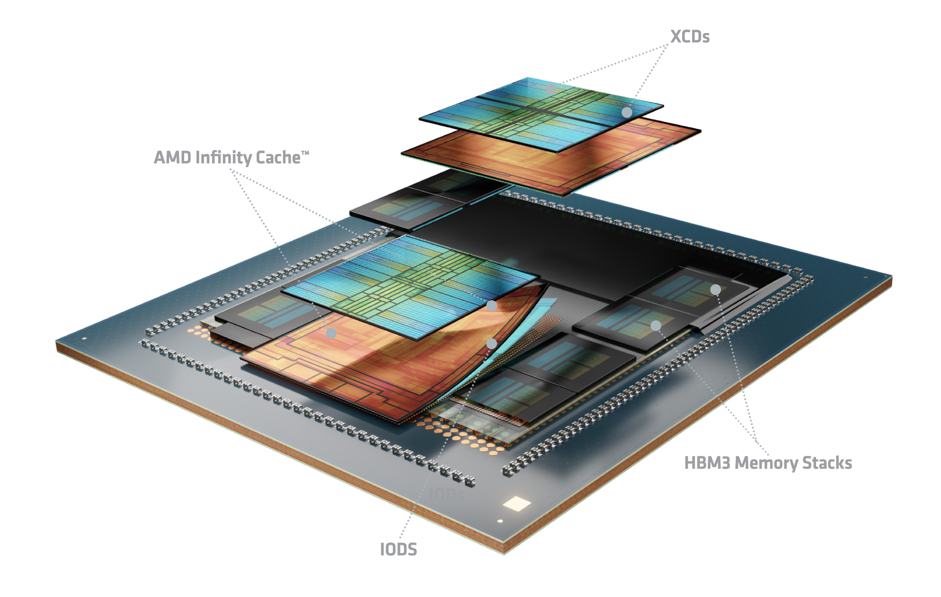
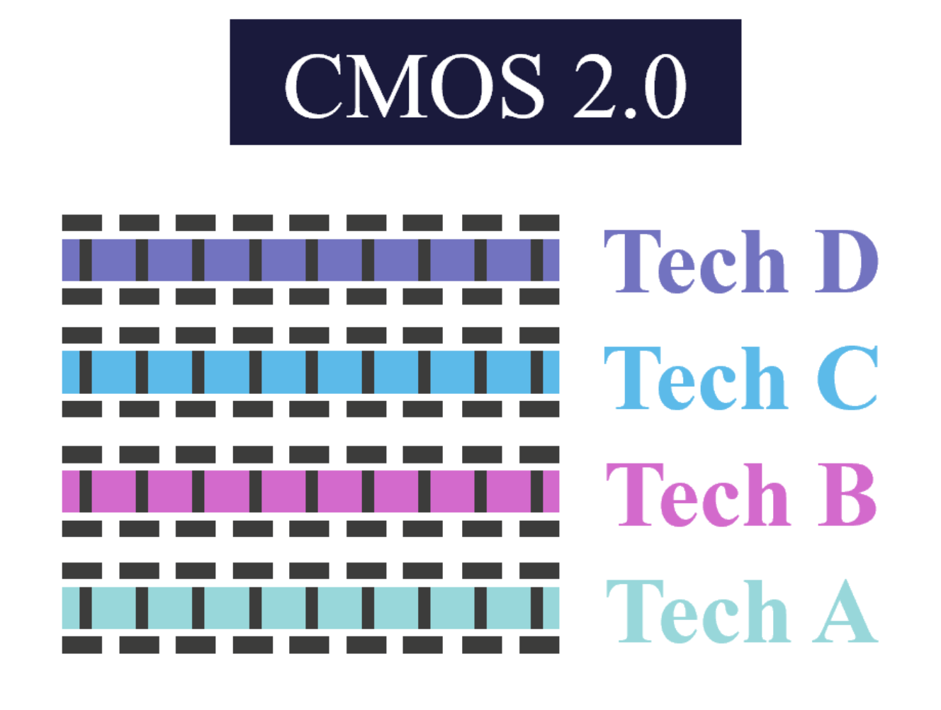
QuantSparse3D: Advanced Integration
3D Modeling and Multi-Node DSE Framework
Traditional CMOS scaling approaches its limits
2.5D Packaging: Multiple active semiconductor dies are placed side-by-side on an interposer
3D Integration: Stacking multiple active semiconductor dies on top of each other
Challenges:
Modern AI compilers are designed for static 2D architectures. AI compilers must match computation and memory characteristics to the heterogeneity across the 3D system
Lack of architectural models of 3D-integrated systems for fast DSE
Moving Forward: 3.5D Integration, CMOS 2.0
AMD Instinct MI350
Cache
XCD
SI Interposer
HBM
Heterogeneous, layer-specialized 3D integration
Fine-pitch HB
Double-sided processing
Advanced integration technology creates heterogeneous tiers that require both accurate architectural modeling and compiler support for tier-aware scheduling and fast DSE

Slide 13
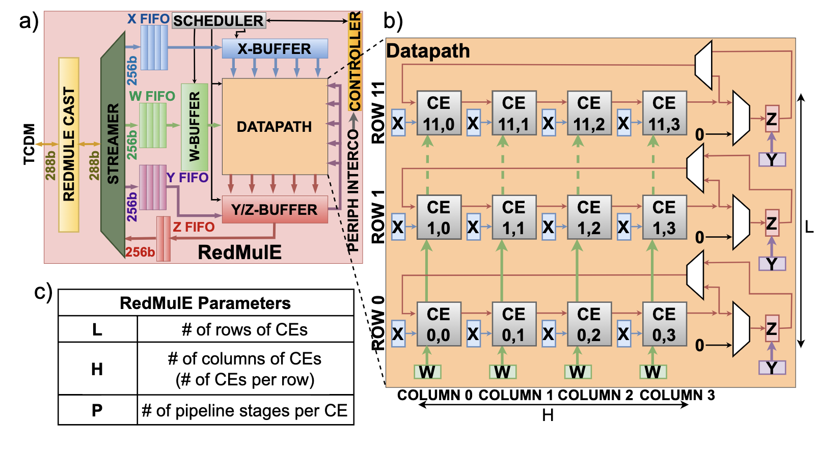
Baseline Architecture: SoftHier
To Sync NoC Router
SoftHier Architecture
System Level
Clusters in 2D-Mesh, HBM as main memory
Clusters and HBM CTRL connected by NoC
Compute Cluster
Vector, Tensor Compute Engines
Snitch – RISC-V Core
TCDM Multi-banked L1
iDMA Engine
GVSoC: Fast and Accurate System-level Simulator
Block-level model integration; calibrate using RTL findings
Provide accurate timing* and fast simulation**
Use GVSoC to evaluate architectural design with end-to-end applications at fast simulation rate
To Data NoC Router
HBM
I $
R
R
R
R
CTRL
REG
Core 0
Comp. Engine
iDMA
C
C
C
C
Core 0
…
C
C
C
C
Core n
R
R
R
R
Interconnect
HBM
HBM
TCDM (Multi-banked L1)
C
C
C
C
R
R
R
R
C
C
C
C
R
R
R
R
Cluster
HBM
Data NoC Router
R
R
Sync NoC Router
* Accurate timing: <10% runtime deviation vs. FPGA emulation of PULP Ips ** Fast simulation: 25 MIPS measured with a 16-core PULP Cluster
Notes:
naming

Slide 14
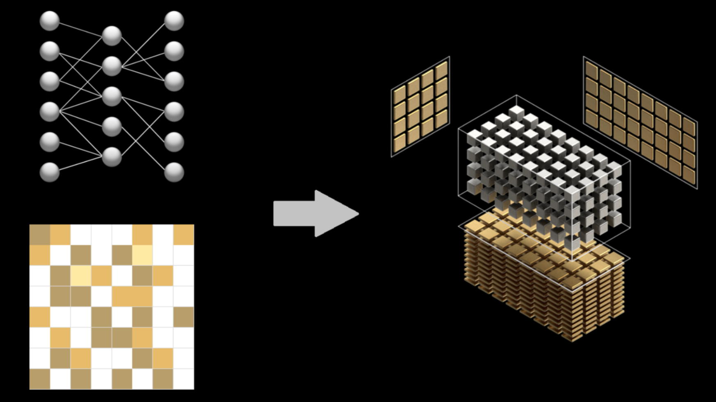
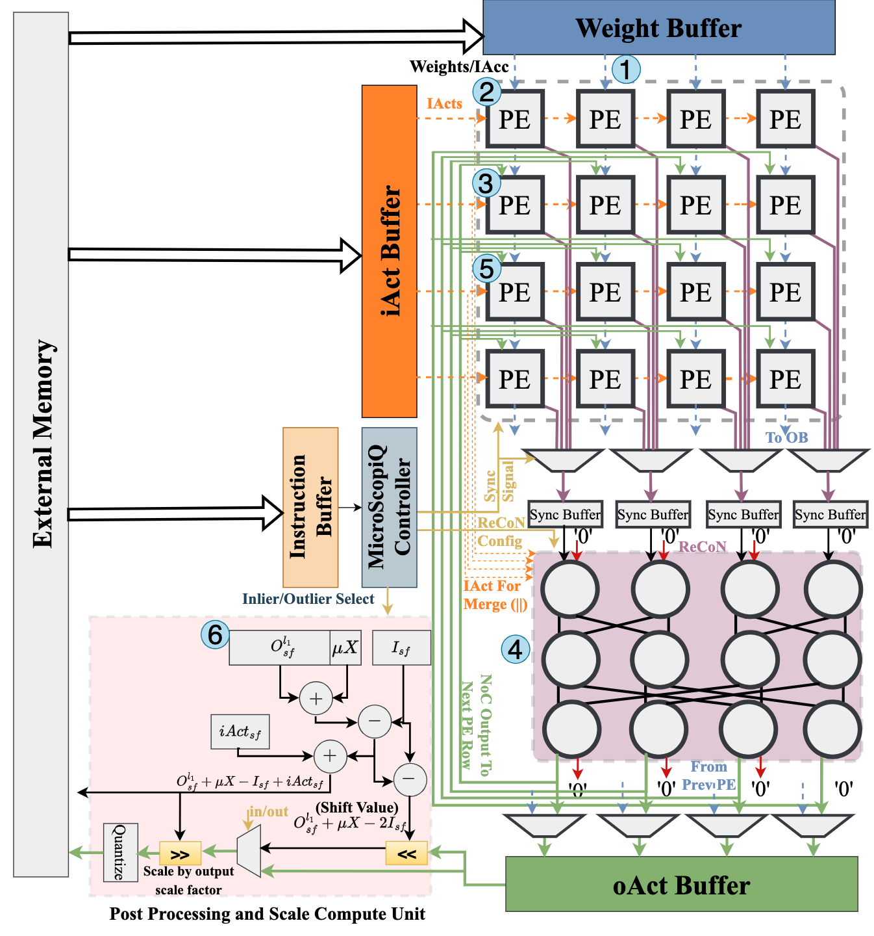
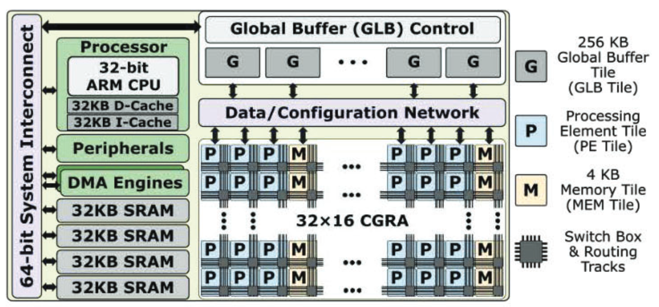
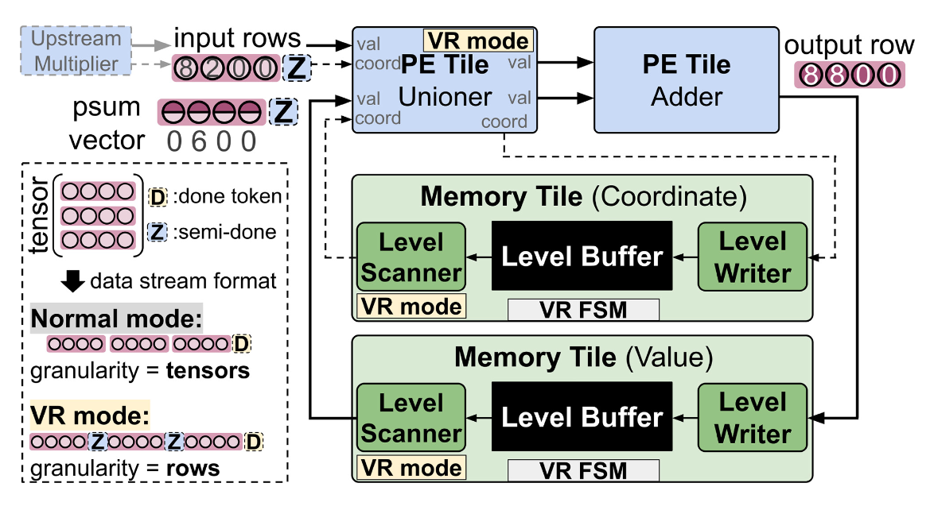
Compute Engine Considerations
Native HW Acceleration for Model Compression
ML models are updated on a weekly basis
Model sparsification and quantization promise substantial efficiency gains
Rapid evolution demands that hardware can adapt fast
Research trends:
NVIDIA Sparse Tensor Core
MicroScopiQ^{[1]}
Bulky Accelerators
Support mapping 2:4 structured sparsity format
WS systolic array for outlier-aware quantization
Format rigidity, Low reusability, Underutilization in inference
FPGA, CGRA-based Designs
Offer programmability but at the cost of energy efficiency
Onxy^{[2]}
Opal^{[3]}
Programmable accelerator for sparse tensor algebra
CGRA for Full Sparse Machine Learning
We need configurable specialization to bridge HW flexibility and efficiency
[1] R. Akshat, et al. "Microscopiq: Accelerating foundational models through outlier-aware microscaling quantization." ISCA ‘25.
[2] K. Kalhan, et al. "Onyx: A 12nm 756 GOPS/W coarse-grained reconfigurable array for accelerating dense and sparse applications." VLSI ‘24.
[3] K. Jahyun, et al. "OPAL: Outlier-Preserved Microscaling Quantization Accelerator for Generative Large Language Models." DAC ‘24.

Slide 15
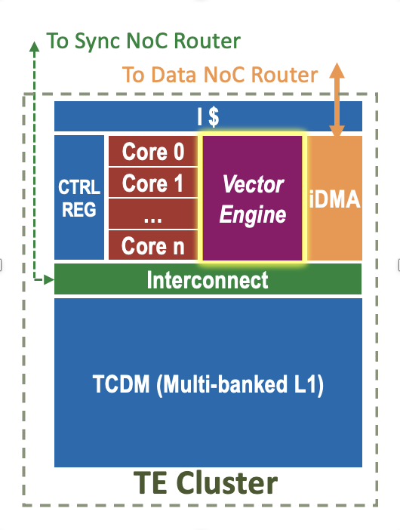
Vector Processor as the Main Compute Engine
Vector engine
Computation speedup on vectorizable operations
→ improved energy efficiency w.r.t scalar cores
Compatible with vector-level operations and multi-granularity sparsity (structured and indexed)
+ Matrix ISA extensions
Arm SME^{[1]}, Intel AMX^{[2]}, and IBM MMA^{[3]}
Direct handling of matrix operations → lowering the instruction fetch and setup overhead
Minimizes the bandwidth demand between VRF and the VAUs → reduced energy consumption

Slide 16
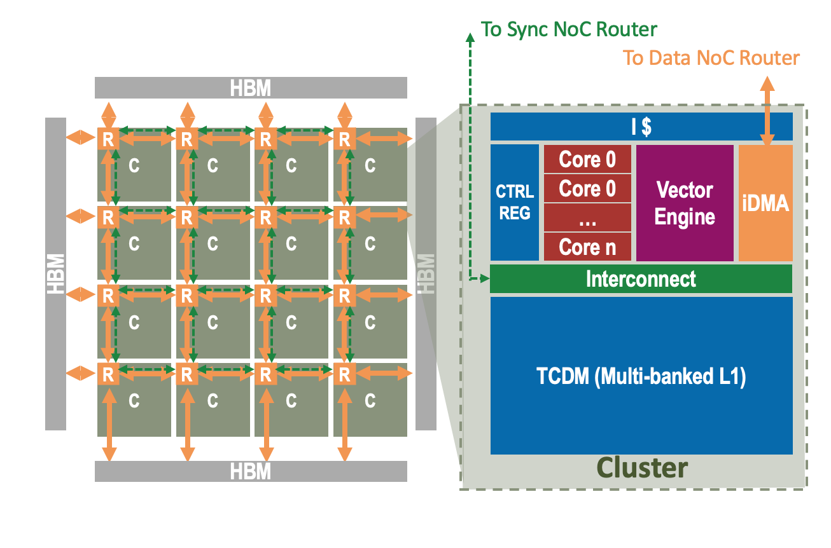
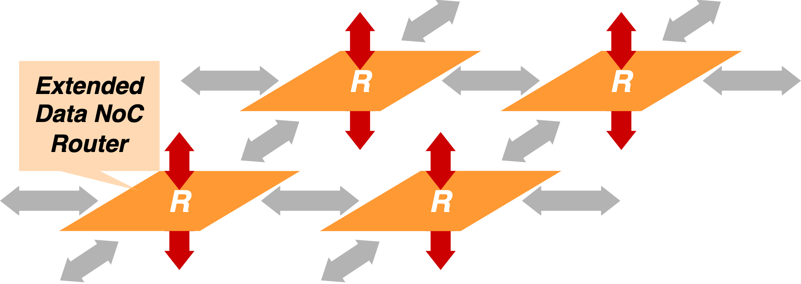
Proposed Architecture
Block Quantization
Customized MX-format in Vec. Engine
Structured Sparsity in Cluster
Efficient scatter/gather unit
Unstructured Sparsity in Cluster
Indirect streaming + scatter/gather unit
Unstructured Sparsity in NoC
Gather from HBM endpoint
3D Architectural Modeling
Router with additional degrees of freedom
Notes:
naming

Slide 17
Proposed Architecture
Block Quantization
Customized MX-format in Vec. Engine
Structured Sparsity in Cluster
Efficient scatter/gather unit
Unstructured Sparsity in Cluster
Indirect streaming + scatter/gather unit
Unstructured Sparsity in NoC
Gather from HBM endpoint
3D Architectural Modeling
Router with additional degrees of freedom
Notes:
naming

Slide 18
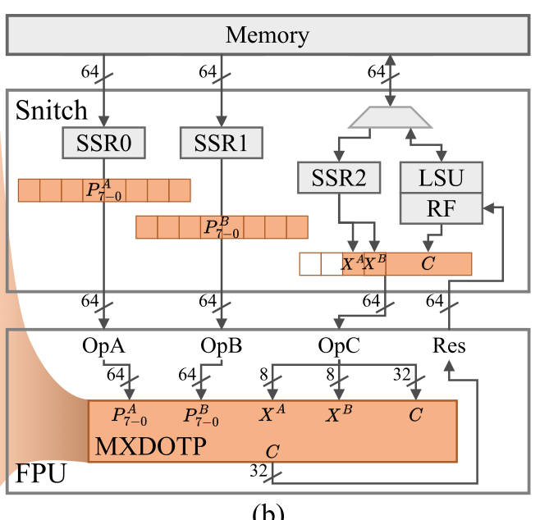
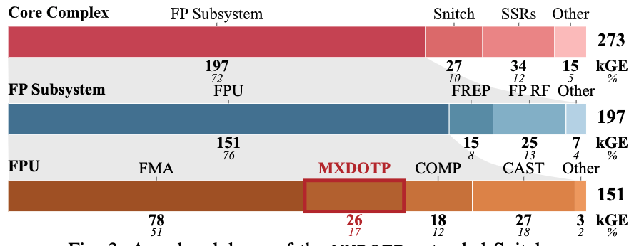
Handling MX Format in the Scalar Processor
MXDOTP^{[1]}: RV ISA Extension for MX Dot Products
MXDOTP operation group
Datapath is integrated into the FPU of the Snitch Cluster as an additional operation group
Computes the dot product between vectors of eight FP8 elements
Throughput: one FP32 result per cycle
Implementation and area analysis
Synthesize, PnR with GF 12nm FinFET
1.09GHz @ TT/0.8V/25°C, with three pipeline stages, without introducing new critical paths
26 kGE per MXDOTP datapath, 17% of FPU area
[1] İslamoğlu, Gamze, et al. "MXDOTP: A RISC-V ISA Extension for Enabling Microscaling (MX) Floating-Point Dot Products." arXiv preprint arXiv:2505.13159 (2025).

Slide 19
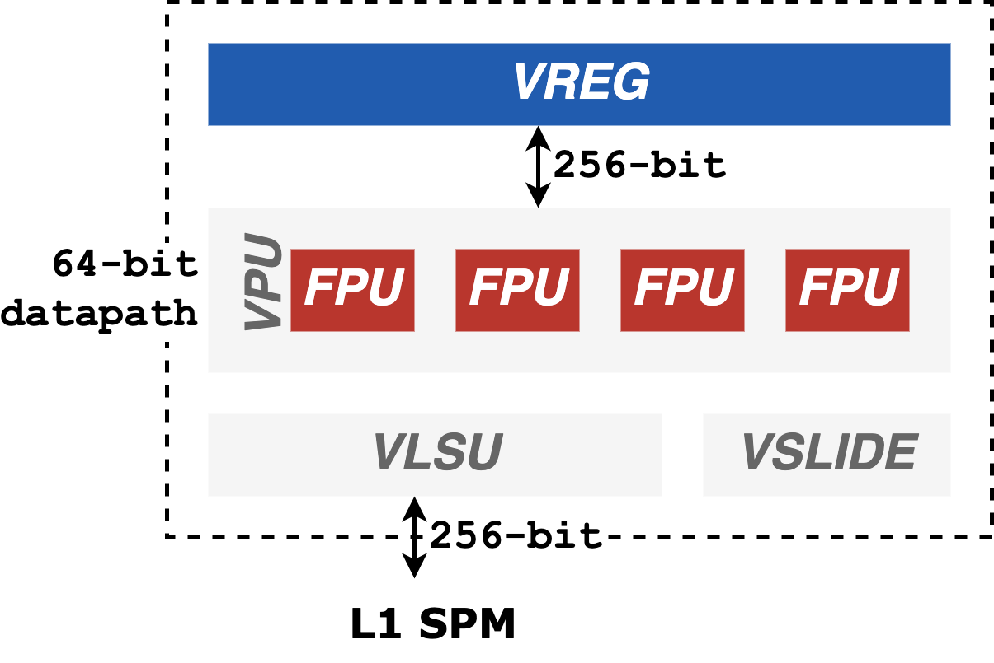
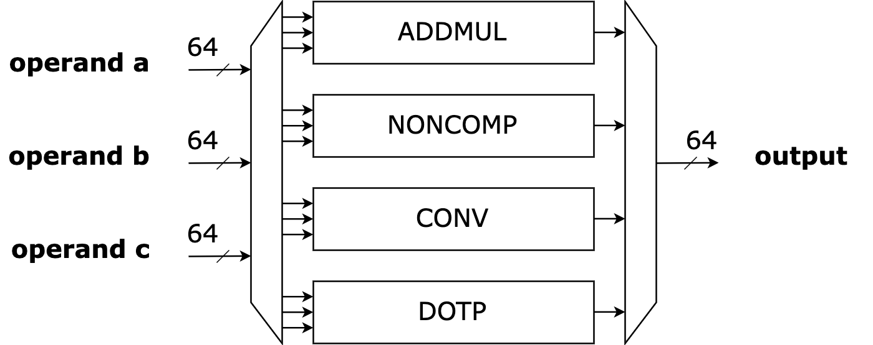
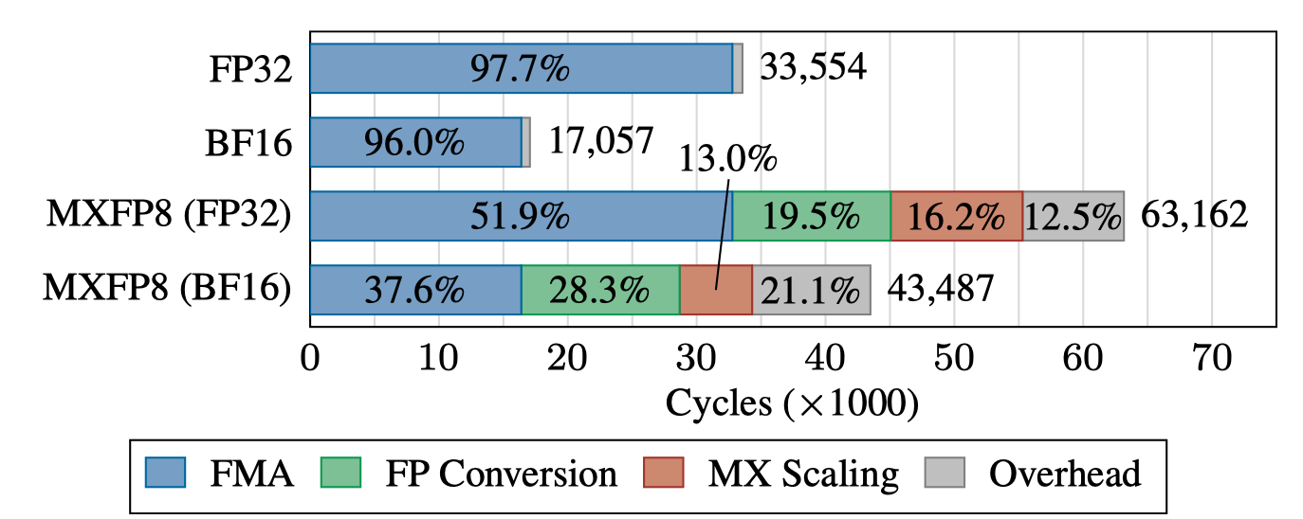
VMXDOTP: Bring MXDOTP Datapath to the Vector Processor
Spatz Datapath and Software Emulated MX kernels
Vector processing unit (VPU)
Comprises four 64-bit FPUs operating in parallel
Connected via 256-bit interconnects to VREG
Software emulation of MXFP8-MatMul Kernel
Gustavson’s algorithm: vectorizes computation along the output matrix’s row dimension
Expend FP8 inputs to FP16, and multiply with widening FMA
Unscaled dot products and the expanded scales are combined using a vector-vector FMA
Design goals:
Eliminate the overhead of software scaling and explicit precision conversion
Must include a fused accumulation step
Support multiple formats and flexible block size
Per FPU workload

Slide 20
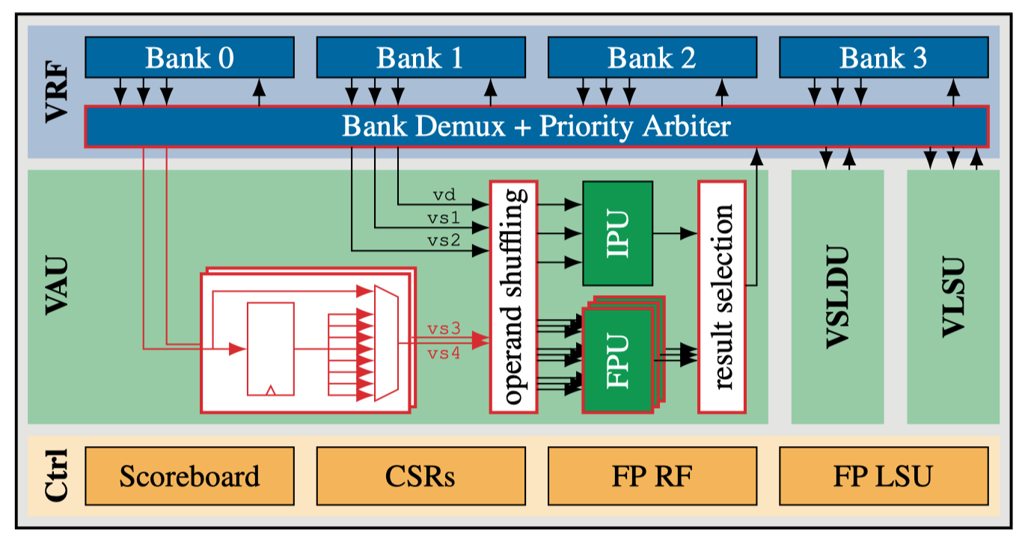
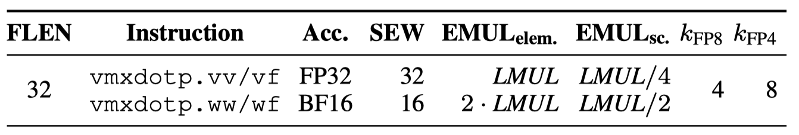
VMXDOTP: Spatz Integration
ISA Extension and PnR Analysis
Spatz Integration
VMXDOTP extension leverages MXDOTP datapath → FPUs in Spatz VPU extended with the MXDOTP operation group
Preliminary encoding for proof-of-concept experiments
Implementation and area analysis
Synthesize, PnR with GF 12nm FinFET. 1.27 GHz @ TT/0.8V/25°C, without introducing new critical paths
Hardware overhead is low:
VMXDOTP-enabled Spatz cluster has a total area of 4.28 MGE: 12.6 % and 7.2 % increment at CC and cluster level
The MX dot-product unit accounts for 82% of the incremental area overhead

Slide 21
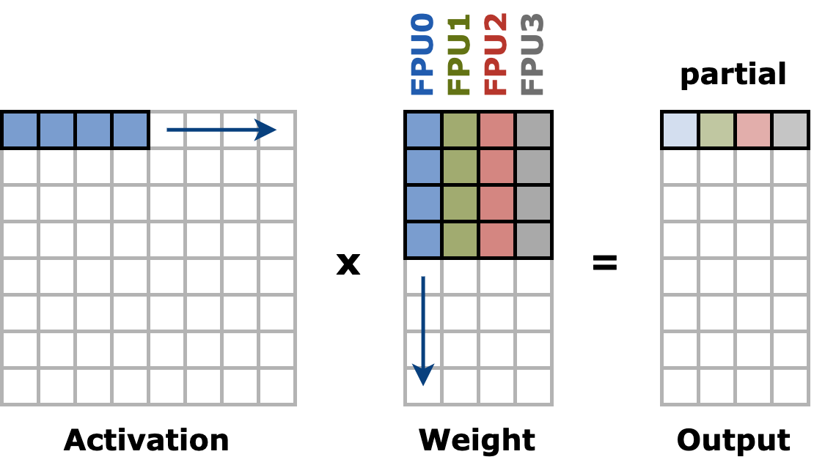
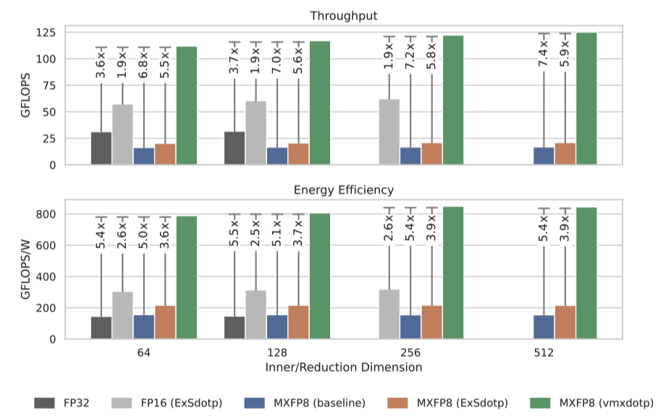
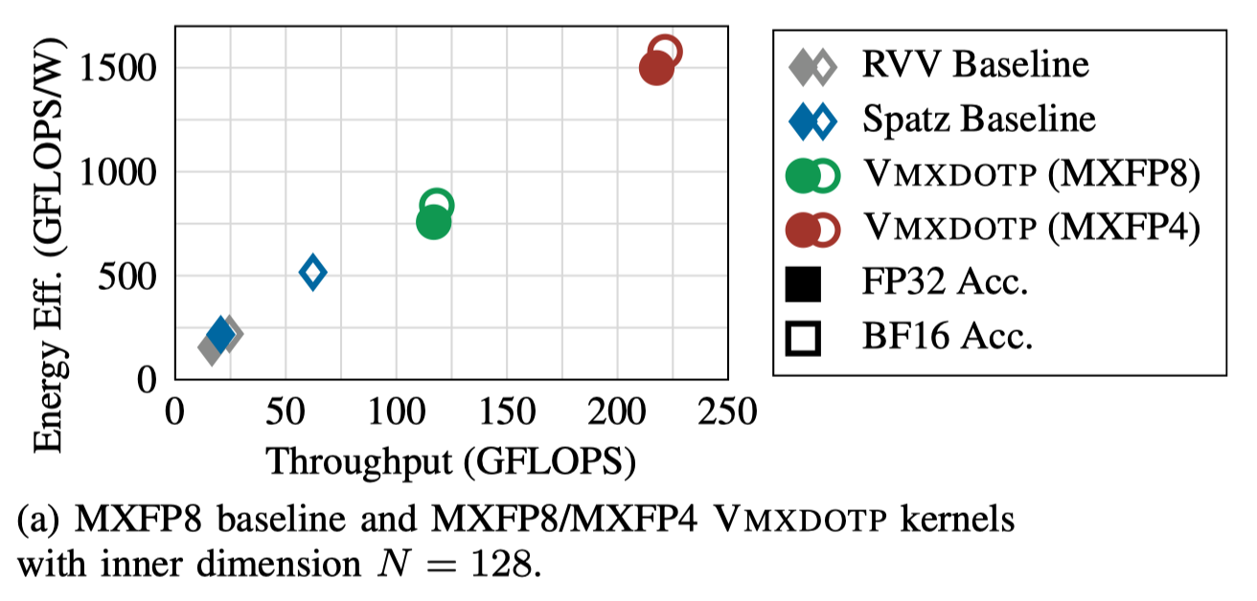
VMXDOTP: Spatz Integration
Per Spatz workload
Kernel Implementation and Benchmark
GEMM Dataflow with VMXDOTP
Activation matrix is row-wise quantized, weight matrix is column-wise quantized
Per FPU operates on an inner-product dataflow
Per Spatz operates on a Gustavson’s-based dataflow
GEMM benchmark
Output dimension: 64x64, sweep the inner dimension from 64 to 512
High performance gain and energy efficiency:
~3.6x, 7.0x speedup at 1.9x, 4.9x energy efficiency comparing with FP32, MXFP8 baseline
MXFP4 VMXDOTP kernels double the throughput and efficiency of their MXFP8 counterparts
FPU utilization of 97.6 %

Slide 22
Proposed Architecture
Block Quantization
Customized MX-format in Vec. Engine
Structured Sparsity in Cluster
Efficient scatter/gather unit
Unstructured Sparsity in Cluster
Indirect streaming + scatter/gather unit
Unstructured Sparsity in NoC
Gather from HBM endpoint
3D Architectural Modeling
Router with additional degrees of freedom
Notes:
naming

Slide 23
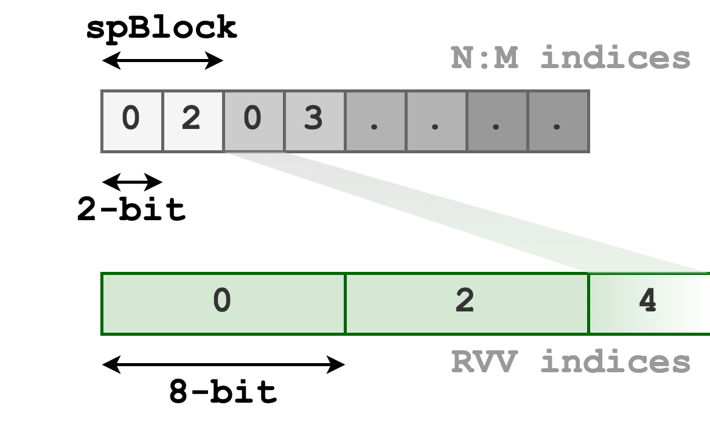
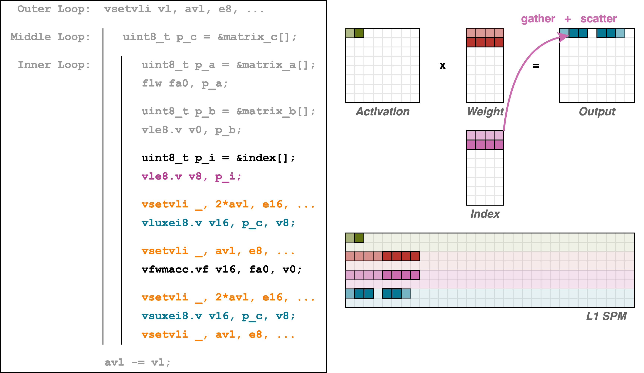
Software Emulation of Structured Sparsity Handling
SpMM Implementation with RVV
1
Index generation is required
1
2
2
No VRF scatter RVV support
→ Use L1 to accumulate
3
3
~50% instructions are used for config + scatter/gather
2
Design insights:
Native hardware support for N:M index formats
Eliminate configuration overhead for distinct SEW
Perform scatter/gather operations in VRF

Slide 24
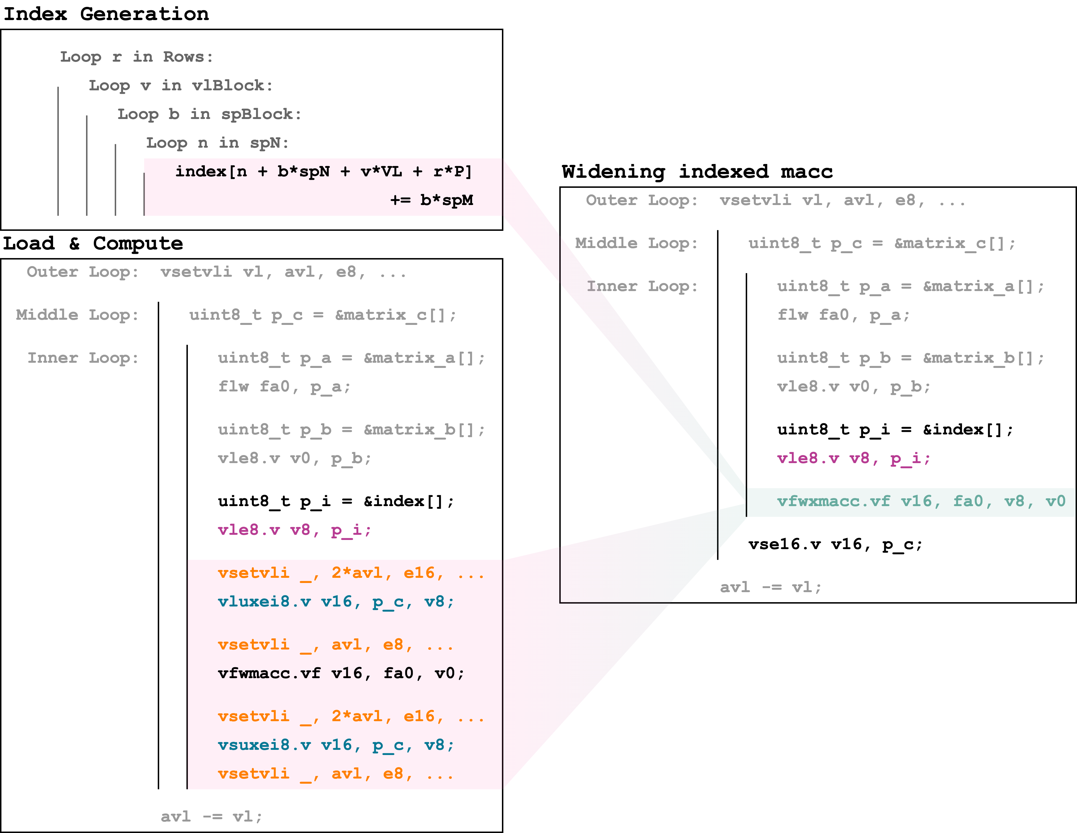
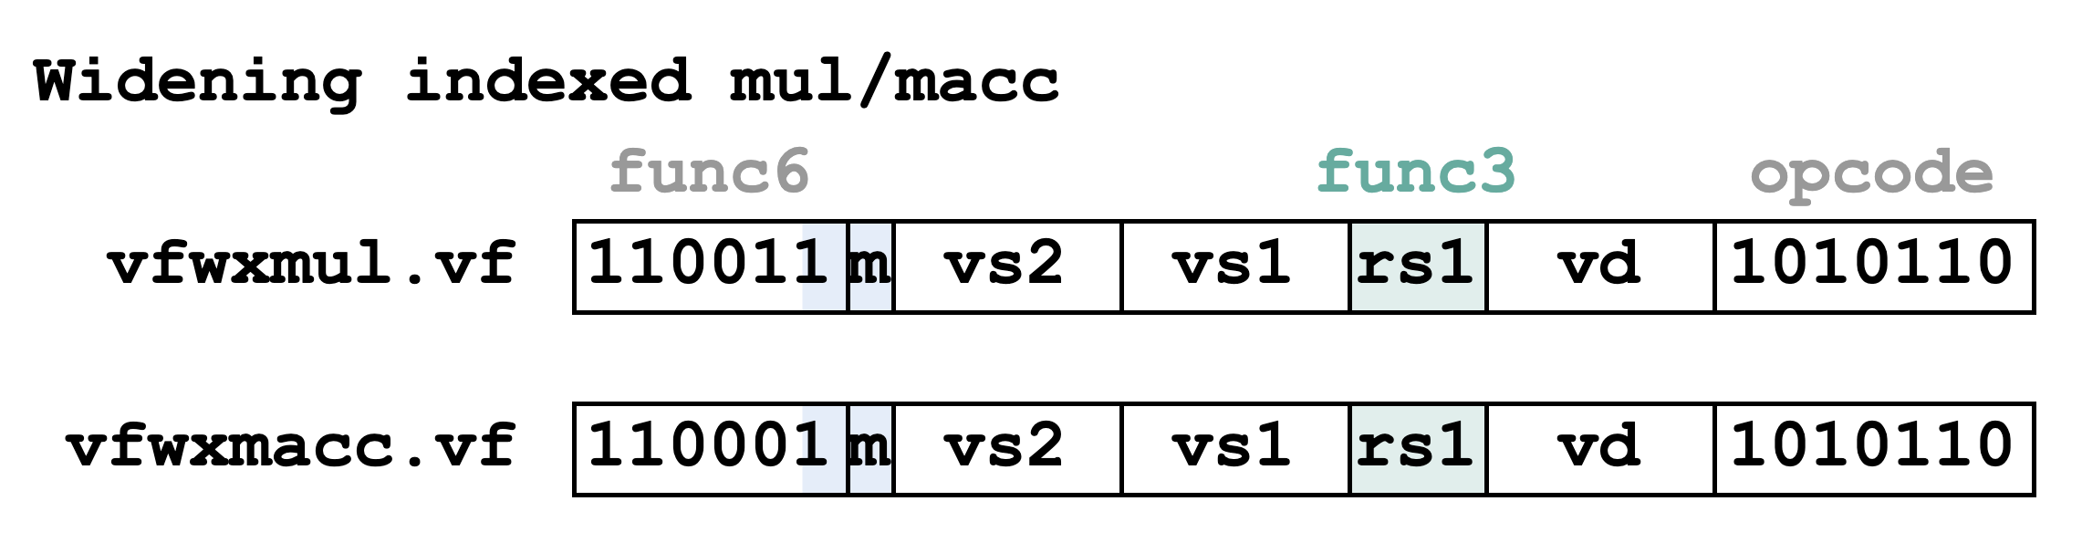
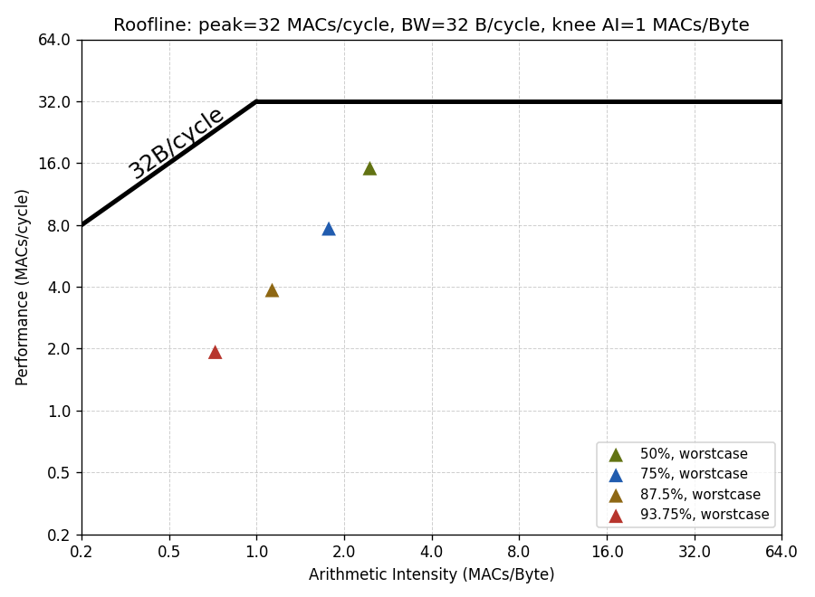
Widening-indexed MACC Instructions
Performance detected from the roofline
Scatter/Gather operation is inefficient → For a 50% sparsity rate, effective VPU throughput is halved
Worse with higher sparsity rate
Merged index translation
Scatter/Gather in VRF
No configuration overhead
32x32x1024 SpMM

Slide 25
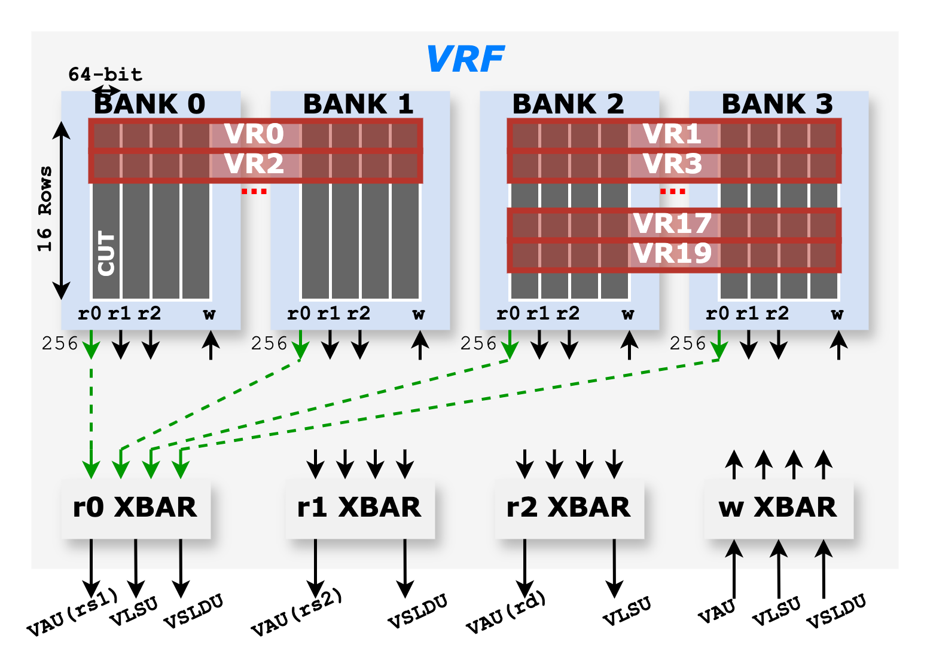
Efficient Scatter/Gather Datapath
Spatz VRF Architecture
Spatz VRF is implemented as a multi-banked, multi-ported, latch-based standard cell memory (SCM)
32 VLENB bytes of the VRF are divided into four banks
three read ports and one write port (3R1W) → Provides enough bandwidth for executing vfmacc.vv instruction
Each with VLENB/2 byte width
In SoftHier, Spatz VLENB = 512 (i.e., 16 KiB VRF)
Spatz has three function units:
VAU: Vector Arithmetic Unit
VLSU: Vector Load/Store Unit
VSLDU: Vector Slides Unit

Slide 26
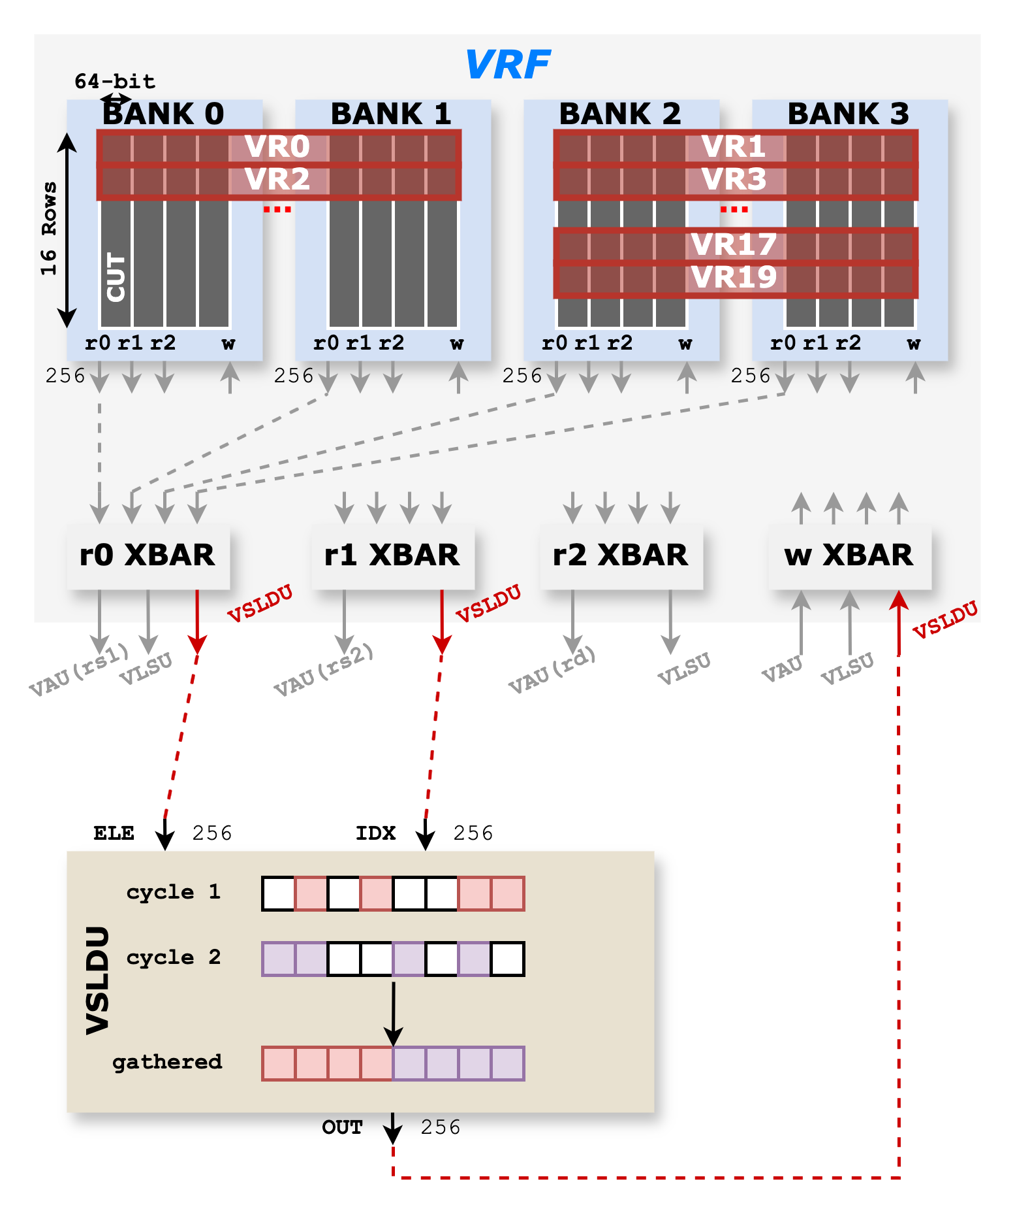
Efficient Scatter/Gather Datapath
Existing VSLDU-based design
Extended VSLDU with an additional port for indices
Support native N:M formats
Limitations:
Throughput bottleneck: With a 50% sparsity rate, Cycle 1 produces the upper-half gathered output, and Cycle 2 produces the lower-half
Lack of streaming: VSLDU gathers a vector from VRF, writes it back, and requires an additional read for arithmetic.
Insights on design requirement:
Asymmetrical bandwidth required to feed VAU at full utilization
Streamlined Scatter/Gather operation with arithmetic

Slide 27
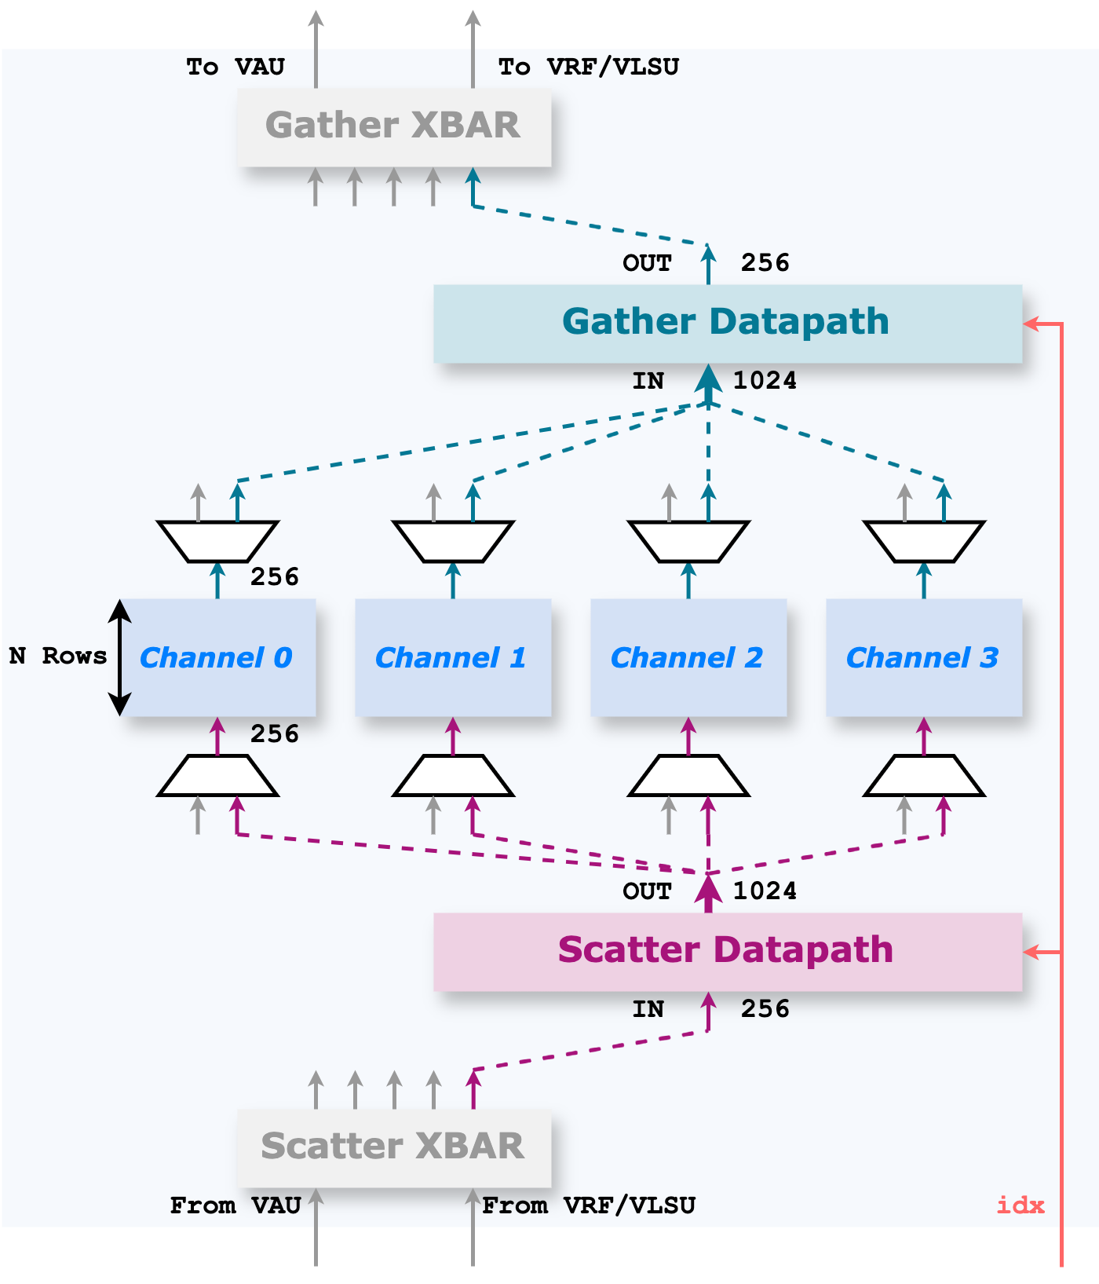
Ventaglio: Efficient Scatter/Gather Datapath
Memory unit
Provide a configurable number of channels (currently 4), each aligned with the VAU datapath granularity
Configurable number of rows, currently 4 rows per channel to support LMUL=8
Implemented with arrays of clock-gated flip-flops
Scatter/Gather datapath
To select the effective elements based on the index vector
Provides asymmetrical interfaces, connecting memory units and the VAU/VRF interfaces
Scatter/Gather crossbars
(Load/Store phase) Route the data stream from VLSU directly into the memory units
(Compute phase) Route the data stream through the scatter/gather datapath

Slide 28
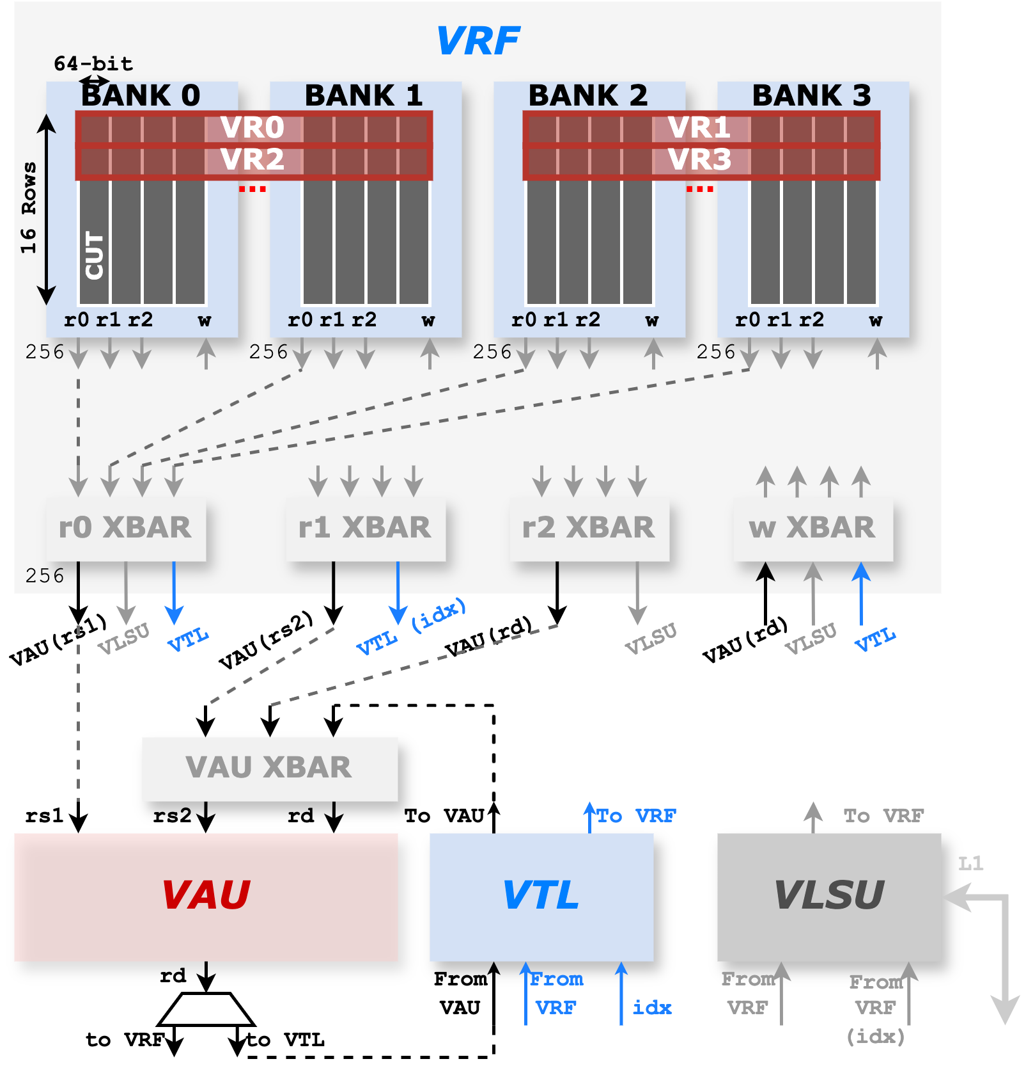
Ventaglio: Efficient Scatter/Gather Datapath
Spatz Integration
VSLDU substitution
VTL is capable of all the functions of VSLDU, exposing the same interface towards VRF
VAU Crossbar
The gather operation can be applied to both activation and accumulation tensors
Applied to the accumulation (i.e., with Gustavson’s dataflow), it is written back to the VTL memory units
With Inner-product-based dataflow (i.e., VMXDOTP), the gather operation is applied to the activation tensor → accumulations are stored back in the VRF

Slide 29
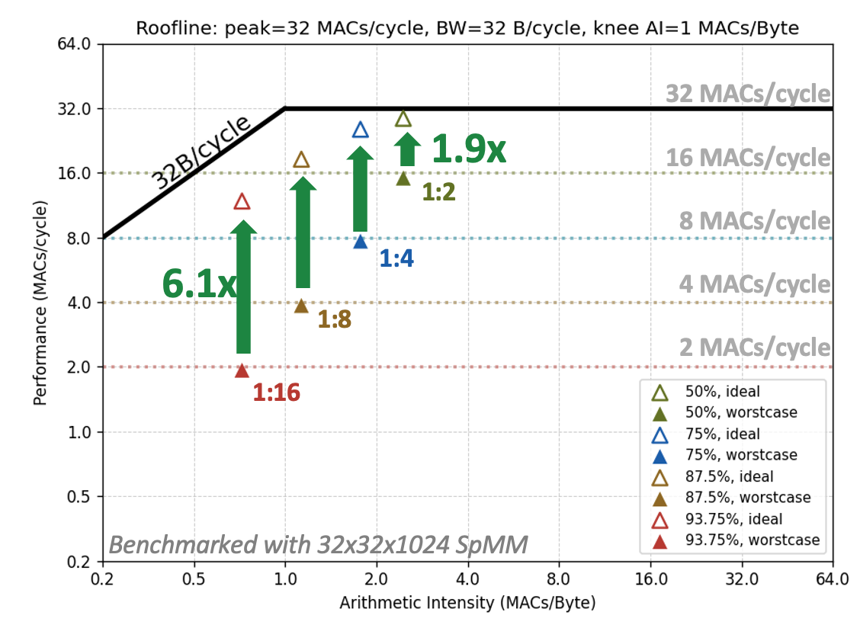
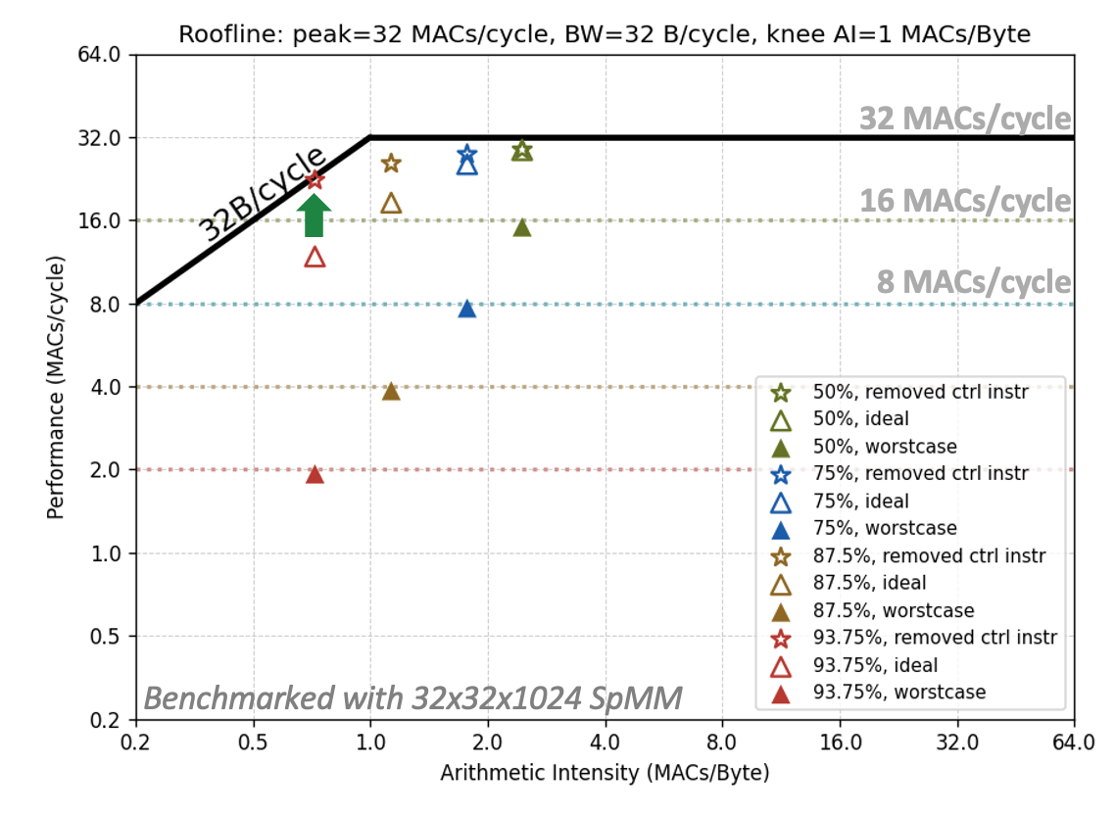

Ventaglio: Efficient Scatter/Gather Datapath
Behavioral Modeling and Benchmark
High performance gain
Achieve 1.9x~6.1x speedup compared with the VSLDU baseline
Still detached from the roofline
Impacts from: Control instructions for address calculation and explicit scalar activation elements loading
More prominent with a higher sparsity rate.
Scalar activation streaming
Address post increment

Slide 30


Joint Handling of Structured Sparsity and MX
Sparsification-axis Consideration
Orthogonal to the MX blocks
Columns of weight elements utilize distinct shared scales
An additional shuffling stage to group elements with the same scales together
Dynamic MAC unit linkage relies on N:M indices
Separate logic blocks for applying scales and accumulation
→ Difficult to scale for various N:M format and MX precisions

Slide 31


Joint Handling of Structured Sparsity and MX
Sparsification-axis Consideration
Orthogonal to the MX blocks
Columns of weight elements utilize distinct shared scales
An additional shuffling stage to group elements with the same scales together
Dynamic MAC unit linkage relies on N:M indices
Separate logic blocks for applying scales and accumulation
→ Difficult to scale for various N:M format and MX precisions
Aligned to the MX blocks
Columns of weight elements share the same MX scales
An additional gathering stage for effective activation elements (Using VTL)
MXDOTP datapath remains unchanged

Slide 32
Proposed Architecture
Block Quantization
Customized MX-format in Vec. Engine
Structured Sparsity in Cluster
Efficient scatter/gather unit
Unstructured Sparsity in Cluster
Indirect streaming + scatter/gather unit
Unstructured Sparsity in NoC
Gather from HBM endpoint
3D Architectural Modeling
Router with additional degrees of freedom
Notes:
naming

Slide 33
Unstructured Sparsity in Cluster: Target Applications
Unstructured weight matrix pruning
Sparsity ratio ~10%
Example methods: OWL^{[1]}, Optimal BERT Surgeon^{[2]}
Weight matrix outlier
From extreme compression scenarios
Example methods: SpQR^{[3]}, SqueezeLLM^{[4]}, GPT3.int8()^{[5]}
Sparsity ratio 0.01-1%
[1] Yin, Lu, et al. "Outlier weighed layerwise sparsity (owl): A missing secret sauce for pruning llms to high sparsity." arXiv preprint arXiv:2310.05175 (2023).
[2] Kurtic, Eldar, et al. "The optimal bert surgeon: Scalable and accurate second-order pruning for large language models." arXiv preprint arXiv:2203.07259 (2022).
[3] Dettmers, Tim, et al. "Spqr: A sparse-quantized representation for near-lossless llm weight compression." arXiv preprint arXiv:2306.03078 (2023).
[4] Kim, Sehoon, et al. "Squeezellm: Dense-and-sparse quantization." arXiv preprint arXiv:2306.07629 (2023).
[5] Dettmers, Tim, et al. "Gpt3. int8 (): 8-bit matrix multiplication for transformers at scale." Advances in neural information processing systems 35 (2022): 30318-30332.

Slide 34

Occamy: Unstructured Sparsity handling with SUs
In Scalar Cores
Streaming units(SU) maximize FPU utilization
Eliminating the control overheads of streaming SPM accesses
Map streams of SPM accesses directly to FP registers, support:
4-D strided accesses
Indirect streams with 8-, 16-, or 32-bit indices
Indices comparison for tensor intersection/union
SUs enable a sustained core-SPM bandwidth
FPU utilization is no longer bound by control overheads → bound by SPM’s throughput

Slide 35

Handle Unstructured Sparsity in Vector Processor
ELLPACK Format
ELLPACK format
Compresses an N×P matrix into two K×P matrices for effective values and row indices
K is the maximum number of non-zero elements per column.
Well-suited for vector-level processing, provided that the number of non-zeros per matrix column does not vary signiﬁcantly
Compress direction

Slide 36




Handle Unstructured Sparsity in Vector Processor
Kernel Implementation with ELLPACK Format
SpMV with ELLPACK format
Each output element results from the reduction between the activation vector and a column of the weight matrix.
Two dataflows are available; Gustavson’s dataflow is preferred
Row indices are used for RVV index-load operation

Slide 37

Case Study: Outliers from SpQR^{[3]} Method
Reproduced on the Llama-2-7B model
Performed a per-layer analysis
Evident outlier patterns:
Attention head patterns: Some heads (e.g., head 0 in this example) contain significantly more outliers.
Row-wise patterns: Corresponding to subsets of output features.
Column-wise patterns: Corresponding to subsets of input features.
Observation:
The number of outliers per matrix row/column vary signiﬁcantly
Column-wise pattern
Row-wise patterns
Attention head pattern
Layer_0: o_proj

Slide 38


Case Study: Outliers from SpQR^{[3]} Method
Limitation of ELLPACK Format
Layer_0: o_proj
Spiking
Row patterns
Compressed
Direction
Well-captured column-wise and attention head patterns
Key challenge: Spiking row patterns
A few rows contain an unusually high number of outliers → a large amount of zero-padding in the ELLPACK value matrix.
Multi-level ELLPACK Format

Slide 39

Multi-Level ELLPACK Format
Removing Zero Padding Through Two-Level Compression
Dynamic compression technique
Fully offline, served as an extension for the existing quantization framework
Dynamic threshold based on weight matrix profiling
Additional overhead: Keep a small column indices vector

Slide 40


Multi-Level ELLPACK Format
Example: SpMV Kernel Implementation

Slide 41

Multi-Level ELLPACK Format
Example: SpMV Kernel Implementation

Slide 42

Multi-Level ELLPACK Format
Example: SpMV Kernel Implementation

Slide 43


Ventaglio: Two-Level Gather Mechanism
Example: 32-bit datapath, 32-bit bank width; FP16 outliers
Block size = L1 Bank width
→ 2 elements per block

Slide 44

Ventaglio: Two-Level Gather Mechanism
Example: 32-bit datapath, 32-bit bank width; FP16 outliers
Block size = L1 Bank width
→ 2 elements per block

Slide 45

Ventaglio: Two-Level Gather Mechanism
Example: 32-bit datapath, 32-bit bank width; FP16 outliers
Block size = L1 Bank width
→ 2 elements per block

Slide 46
Proposed Architecture
Block Quantization
Customized MX-format in Vec. Engine
Structured Sparsity in Cluster
Efficient scatter/gather unit
Unstructured Sparsity in Cluster
Indirect streaming + scatter/gather unit
Unstructured Sparsity in NoC
Gather from HBM endpoint
3D Architectural Modeling
Router with additional degrees of freedom
Notes:
naming

Slide 47

V-Cache Gather for Sparse Attention
Decode: sparse (e.g. top-k) attention gathers vectors from V cache
V cache is in HBM, cannot fit in SPM
Entries may be as narrow as NoC bus (Llama-3: h=128 @ 4b → 512b)
V
gathered V_vecs
sparse attn. a
v₁
output z
a₁
a₃
a_{s}
v₃
0
0
a₄
0
0
v₄
V cache
v_{s}
Ctrl.
Cluster tile
HBM Endp. 0
iDMA
a_idcs
Ctrl.
HBM Endp. 1
req. gen
NoC NI + Router
TCDM (Multi-banked L1)
NoC Mesh
Ctrl.
V_vecs
HBM Endp. 2
response writeback
gather(a_idcs, V_vecs)
Ctrl.
HBM Endp. 3
Indices
DMA control core
Req 0: E1
Req 1: E0
Req 2: E1
Req 3: E1
Req 4: E2
Req 5: E3

Slide 48
V-Cache Gather for Sparse Attention
Decode: sparse (e.g. top-k) attention gathers vectors from V cache
V cache is in HBM, cannot fit in SPM
Entries may be as narrow as NoC bus (Llama-3: h=128 @ 4b → 512b)
Benefits from efficient mechanism to gather short vectors from HBM
V
gathered V_vecs
sparse attn. a
v₁
output z
a₁
a₃
a_{s}
v₃
0
0
a₄
0
0
v₄
V cache
v_{s}
Ctrl.
Cluster tile
HBM Endp. 0
iDMA
Rsp 1: E0
a_idcs
Ctrl.
HBM Endp. 1
req. gen
Rsp 3: E1
Rsp 0: E1
NoC NI + Router
Rsp 2: E1
TCDM (Multi-banked L1)
NoC Mesh
Ctrl.
V_vecs
HBM Endp. 2
response writeback
Rsp 4: E2
gather(a_idcs, V_vecs)
Ctrl.
HBM Endp. 3
DMA control core
Rsp 5: E3

Slide 49
V-Cache Gather for Sparse Attention
Decode: sparse (e.g. top-k) attention gathers vectors from V cache
V cache is in HBM, cannot fit in SPM
Entries may be as narrow as NoC bus (Llama-3: h=128 @ 4b → 512b)
Benefits from efficient mechanism to gather short vectors from HBM
Extend cluster DMA with indexed gather
Read selected attention indices from cluster TCDM
Collect, pack requests per HBM endpoint
V
gathered V_vecs
sparse attn. a
v₁
output z
a₁
a₃
a_{s}
v₃
0
0
a₄
0
0
v₄
V cache
v_{s}
Cluster tile
HBM Endp. 0
Req 0, 2, 3
size=3
gather burst handler
iDMA
Req 1
size=1
Req 4
size=1
Ctrl.
a_idcs
endpoint packing
Indices
req. gen
Req 5
size=1
NoC NI + Router
NoC Mesh
TCDM (Multi-banked L1)
wb info
HBM Endp. 1
V_vecs
response writeback
HBM Endp. 2
gather(a_idcs, V_vecs)
DMA control core
HBM Endp. N
Req
size=6

Slide 50
V-Cache Gather for Sparse Attention
Decode: sparse (e.g. top-k) attention gathers vectors from V cache
V cache is in HBM, cannot fit in SPM
Entries may be as narrow as NoC bus (Llama-3: h=128 @ 4b → 512b)
Benefits from efficient mechanism to gather short vectors from HBM
Extend cluster DMA with indexed gather
Read selected attention indices from cluster TCDM
Collect, pack requests per HBM endpoint
HBM endpoints send back packed bursts of needed V-cache vectors
Increased bandwidth efficiency
V
gathered V_vecs
sparse attn. a
v₁
output z
a₁
a₃
a_{s}
v₃
0
0
a₄
0
0
v₄
V cache
v_{s}
Cluster tile
HBM Endp. 0
iDMA
gather burst handler
Rsp 1
size=1
a_idcs
endpoint packing
Ctrl.
req. gen
NoC NI + Router
NoC Mesh
Rsp 0, 2, 3
size=3
TCDM (Multi-banked L1)
wb info
HBM Endp. 1
V_vecs
response writeback
Rsp 4
size=1
HBM Endp. 2
gather(a_idcs, V_vecs)
Rsp 5
size=1
DMA control core
HBM Endp. N

Slide 51
Proposed Architecture
Block Quantization
Customized MX-format in Vec. Engine
Structured Sparsity in Cluster
Efficient scatter/gather unit
Unstructured Sparsity in Cluster
Indirect streaming + scatter/gather unit
Unstructured Sparsity in NoC
Gather from HBM endpoint
3D Architectural Modeling
Router with additional degrees of freedom
Notes:
naming

Slide 52


3D Router Modeling
Design Principles for Inter-Chiplet/Inter-Cluster Interconnect Topology
Minimize the network diameter
Why: fewer hops → fewer routers involved per packet → lower latency, lower congestion, lower energy
Tune the link range
Shorter links → higher signaling rate (i.e., lower RC).
Trade-off: shorter links require more routers to maintain reachability, thus a larger network diameter
Optimize the Router Radix
Higher radix → smaller network diameter
Trade-off: Higher radix increases area, buffering, crossbar size, and control complexity
Key insight:
Lowering the network diameter often requires increasing the radix, but the area/bandwidth trade-off must be modeled.

Slide 53
3D Router Modeling
Design Principles for Inter-Chiplet/Inter-Cluster Interconnect Topology
Design goals:
Extend the router model with 3D-aware degrees of freedom to capture:
Vertical vs. lateral link allocation
Hybrid 2.5D–3D topologies
Variable link lengths and link-quality scaling
Capture the quantitative trade-off between router radix, area overhead, and per-port bandwidth.
Model how link range and network diameter co-determine latency, congestion, and throughput.
3D router modeling baseline
Adding two degrees of freedom along the Z-dimension
Defining the lower bound on routing distance and network diameter

Slide 54
Proposed Architecture
Block Quantization
Customized MX-format in Vec. Engine
Structured Sparsity in Cluster
Efficient scatter/gather unit
Unstructured Sparsity in Cluster
Indirect streaming + scatter/gather unit
Unstructured Sparsity in NoC
Gather from HBM endpoint
3D Architectural Modeling
Router with additional degrees of freedom
Notes:
naming

Slide 55

Review of First-Year Work Package
(WP1.1) Architectural modeling, simulation, and design of the chiplet architecture
[Done] Modeled (widened) indexed-macc in the vector processor Spatz for sparsity handling
[Done] Modeled vmxdotp instructions in Spatz for block quantization data format handling
[Done] Modeled on-chip interconnect, memories, and main memory endpoints.
[Finishing] Modeled controller and collecting packets in the main memory endpoint
(WP1.2) Parameterized RTL models
[Done] MXDOTP operation group has been integrated into Spatz. It is synthesized with the GF12 technology node and performs PPA analysis.
[Done] RTL implementation of controller in main memory endpoint
[Ongoing] The Ventaglio gather and scatter datapath is being integrated into Spatz. – Expect to finish in November (M9)

Slide 56
Review of First-Year Work Package
(WP2.1) Architectural modeling of 3D-stacked memories
[Finishing] Extend the router model with optional 3D (z-up and z-down) routing – Expect to finish in November (M9)
(WP2.2) Software environment for LLM Deployment
[Done] Extended SoftHier runtime with dynamic memory allocation in both L1 SPM and HBM.
[Done] Integrated the SoftHier runtime and basic kernel templates into the Deeploy framework. Achieved single-cluster microkernel deployment.
[Ongoing] Extending the deployment framework to support multi-node architectures. – Expect to finish in January (M11)
(WP2.3) DSE for simplified end-to-end models and microkernels
[Done] Implemented microkernels for SpMM and SpMV kernels with structured sparse weight matrix and unstructured activations. GEMM and GEMV kernels with MX block quantization format.
[Ongoing] Proposed multi-level ELLPACK format for SpMV kernel with unstructured sparse weight matrix. HW-SW co-design with Ventaglio scatter/gather datapath. – Expect to finish in December (M10)
[Pending] Implementation of end-to-end model deployment. – Expect to finish in February (M12)

Slide 57

Ventaglio: Efficient Scatter/Gather Datapath
Example: Inner-Product Dataflow
Loading stage
Vector of activation elements is loaded from L1 through VLSU, and written to the memory units in VTL → bypassing VRF

Slide 58

Ventaglio: Efficient Scatter/Gather Datapath
Example: Inner-Product Dataflow
Loading stage
Vector of activation elements is loaded from L1 through VLSU, and written to the memory units in VTL → bypassing VRF
Compute stage
Effective activation elements are gathered with indices
The vector of weight elements and output accumulations are streamed from VRF
Decoupled loading stage and compute stage

Slide 59

Ventaglio – Spatz Integration
Gustavson’s dataflow example
Vector of weight elements is streamed from VRF (rs1)
Scalar activation elements are read from scalar registers
Vector of output accumulations is gathered-read from VTL, and scattered-write back to VTL
Indices are read from the VRF

